Slide 1

MEEN 689 Computing Concepts
Project 3
Group Name: Nebula
Members: Mingxin Dong, Amira Bushagour, Vishal Indivar Kandala, Yash Narendra, Thomas Firsich, Shah Akib Sarwar

Slide 2
Listen
Brute Force
Example
Brute Force
Listen
Example
Listen
Implement
Implement
Walk through
Walk through
Optimize
Optimize
TEST
TEST

Slide 3

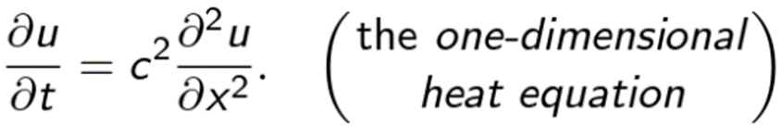
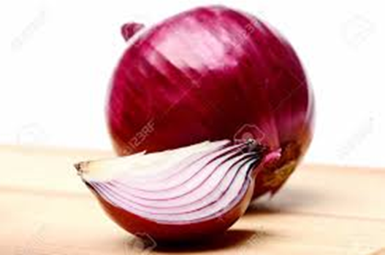
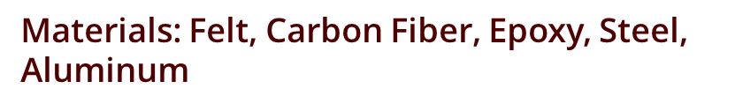
Listen

Slide 4
Material Configurations
 | Thickness [m]
Material | Layup 1 | Layup 2 | Layup 3 | Layup 4
Felt Insulation | 0.02 | 0.03 | 0.02 | 0.005
Carbon Fiber | 0.005 | 0.003 | 0.01 | 0.0001
Epoxy | 0.001 | 0.001 | 0.001 | 0.001
Carbon Fiber | 0.008 | 0.012 | 0.012 | 0.0001
Epoxy | 0.001 | 0.001 | 0.001 | 0.001
Aluminum | 2 | 2.3 | 1.7 | 2.8
Steel | 1.965 | 1.653 | 2.256 | 1.1928
 | Boundary Conditions [W/cm²]
 | 2 | 4 | 3.2 | 5

Slide 5
Example
Brute Force
Example
Brute Force
Listen
Example
Listen
Implement
Implement
Walk through
Walk through
Optimize
Optimize
TEST
TEST

Slide 6
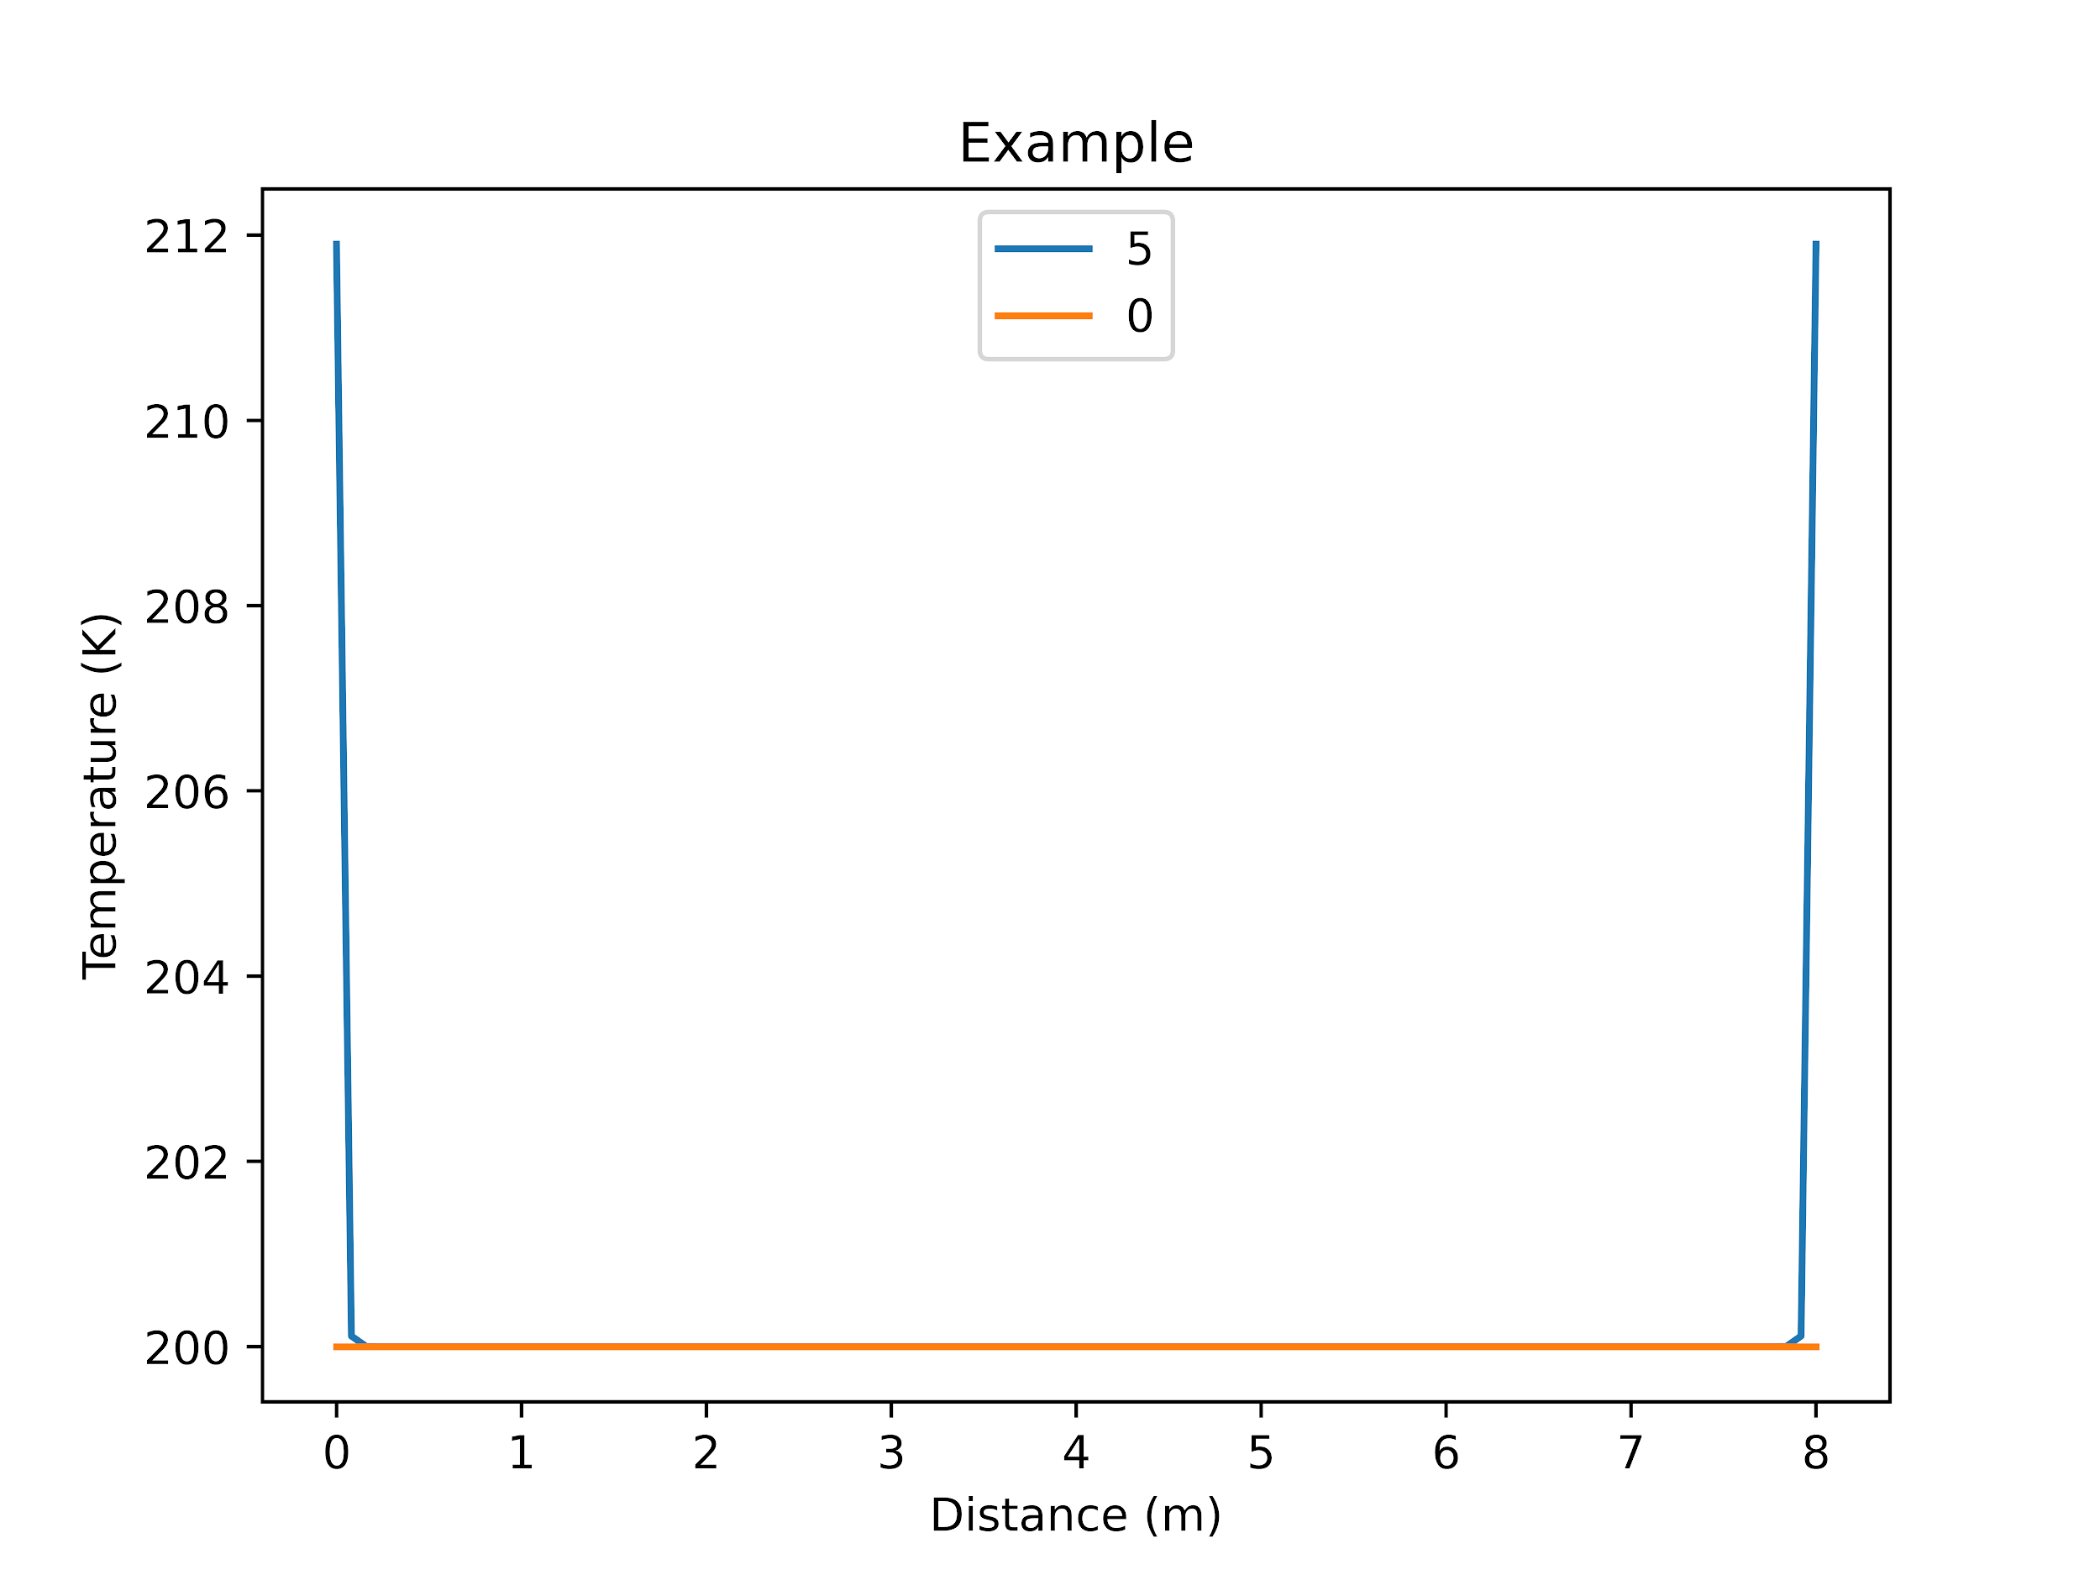
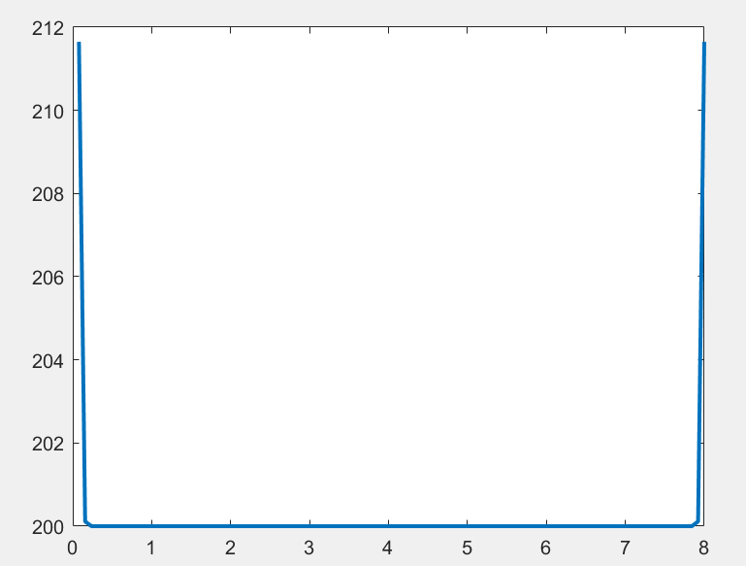
Example
Test Case:
Solid steel ball
Uniform heat flux on both sides
Small total time
Compared results to a matlab solver

Slide 7
Brute Force: Analytical Solutions
Brute Force
Example
Brute Force
Listen
Example
Listen
Implement
Implement
Walk through
Walk through
Optimize
Optimize
TEST
TEST

Slide 8
High Level
8 Inputs on command line
Loop through time steps
generate A matrix by looping through radii
solve system for temperature of next time step (implicit solution)
populate time matrix
check for material failure

Slide 9
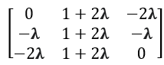
Thomas Algorithm
Utilized implicit solution
Simplified gaussian elimination for tridiagonal matrices
Utilizes backwards substitution to solve for next time step
Used an nX3 matrix to store upper, middle, and lower diagonal values

Slide 10
Optimize
Listen
Example
Brute Force
Implement
Walk through
Optimize
TEST

Slide 11
Matrix A Copy
Duplicated work inside of solver
Matrix A was generated at each time step
Generated A outside of the solver and assigned to a placeholder matrix to be used for manipulation.

Slide 12
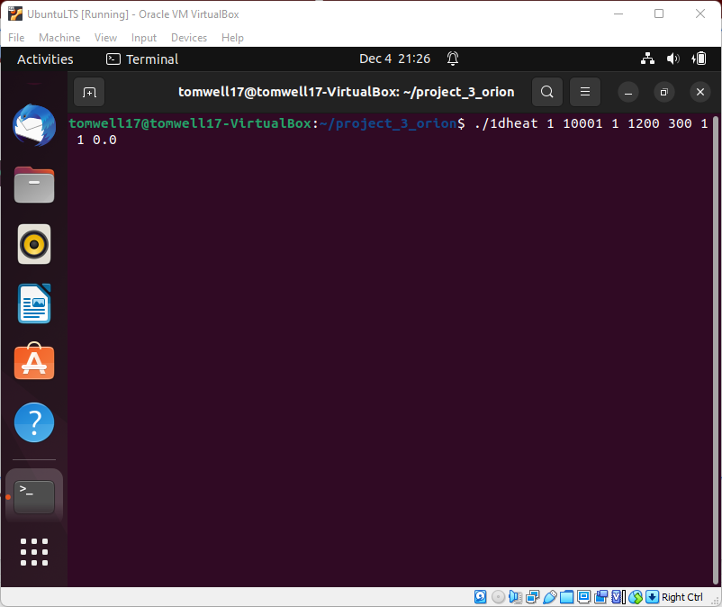
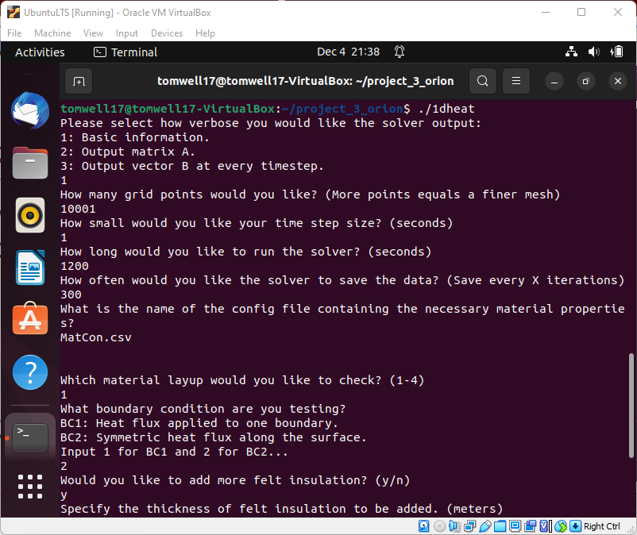
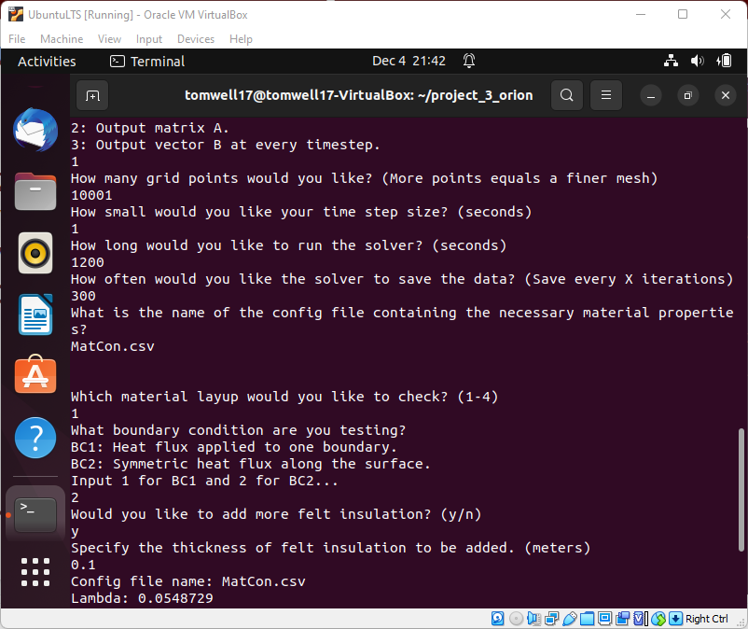
Command Line User-Inputs
Solver parameters:
verbose
grid size
time step size
final time
saving interval
material layup
boundary condition
felt added

Slide 13
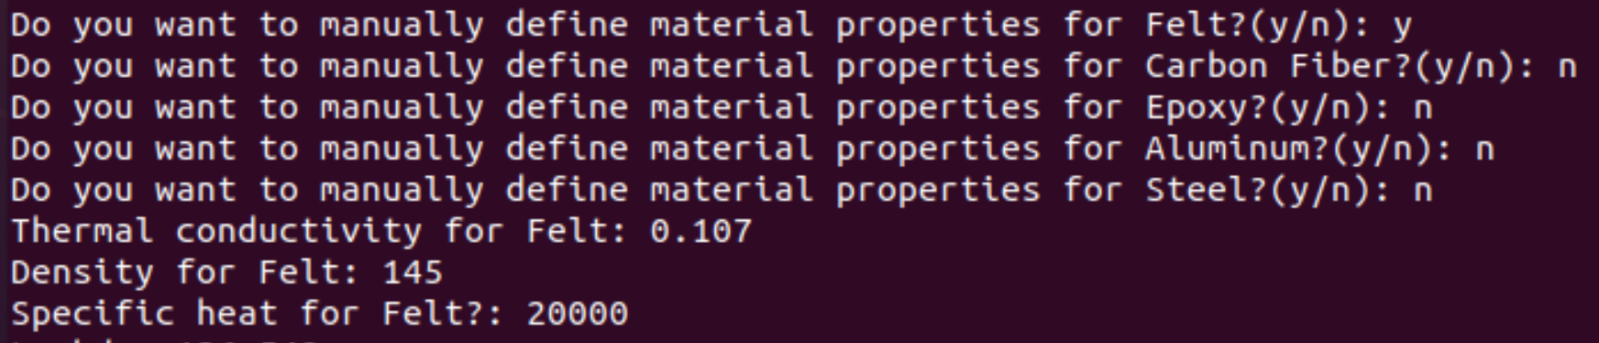
Class Implementation
‘Material’ class for creating different materials
Each material has four member variables - diffusivity,
thermal conductivity, specific heat and density
User can use
command line
inputs to modify
material
properties

Slide 14
Configuration File
Config file inputs for each material:
Specific heat: C_{p}
Thermal conductivity: k
Density: ⍴
Glassing temperature: T_{glass}
*User should only change the variable values
“MatCon.csv”
VARIABLE | VALUE
Felt_Cp | 20000
CF_Cp | 1100
Epoxy_Cp | 1730
Al_Cp | 890
SS_Cp | 510
Felt_k | 0.107
CF_k | 10

Slide 15
Walk through
Listen
Example
Brute Force
Implement
Walk through
Optimize
TEST

Slide 16
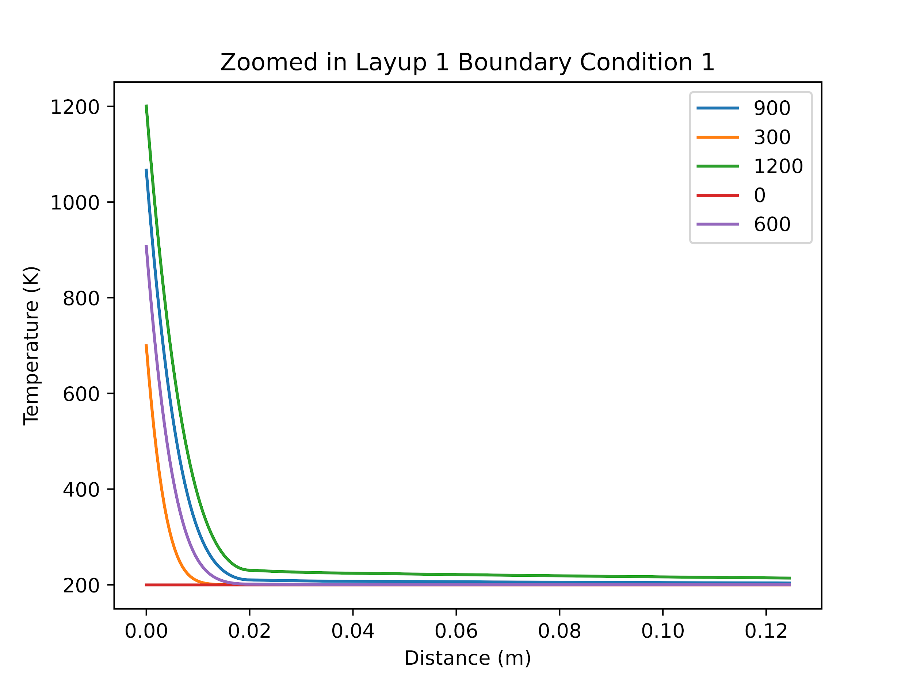
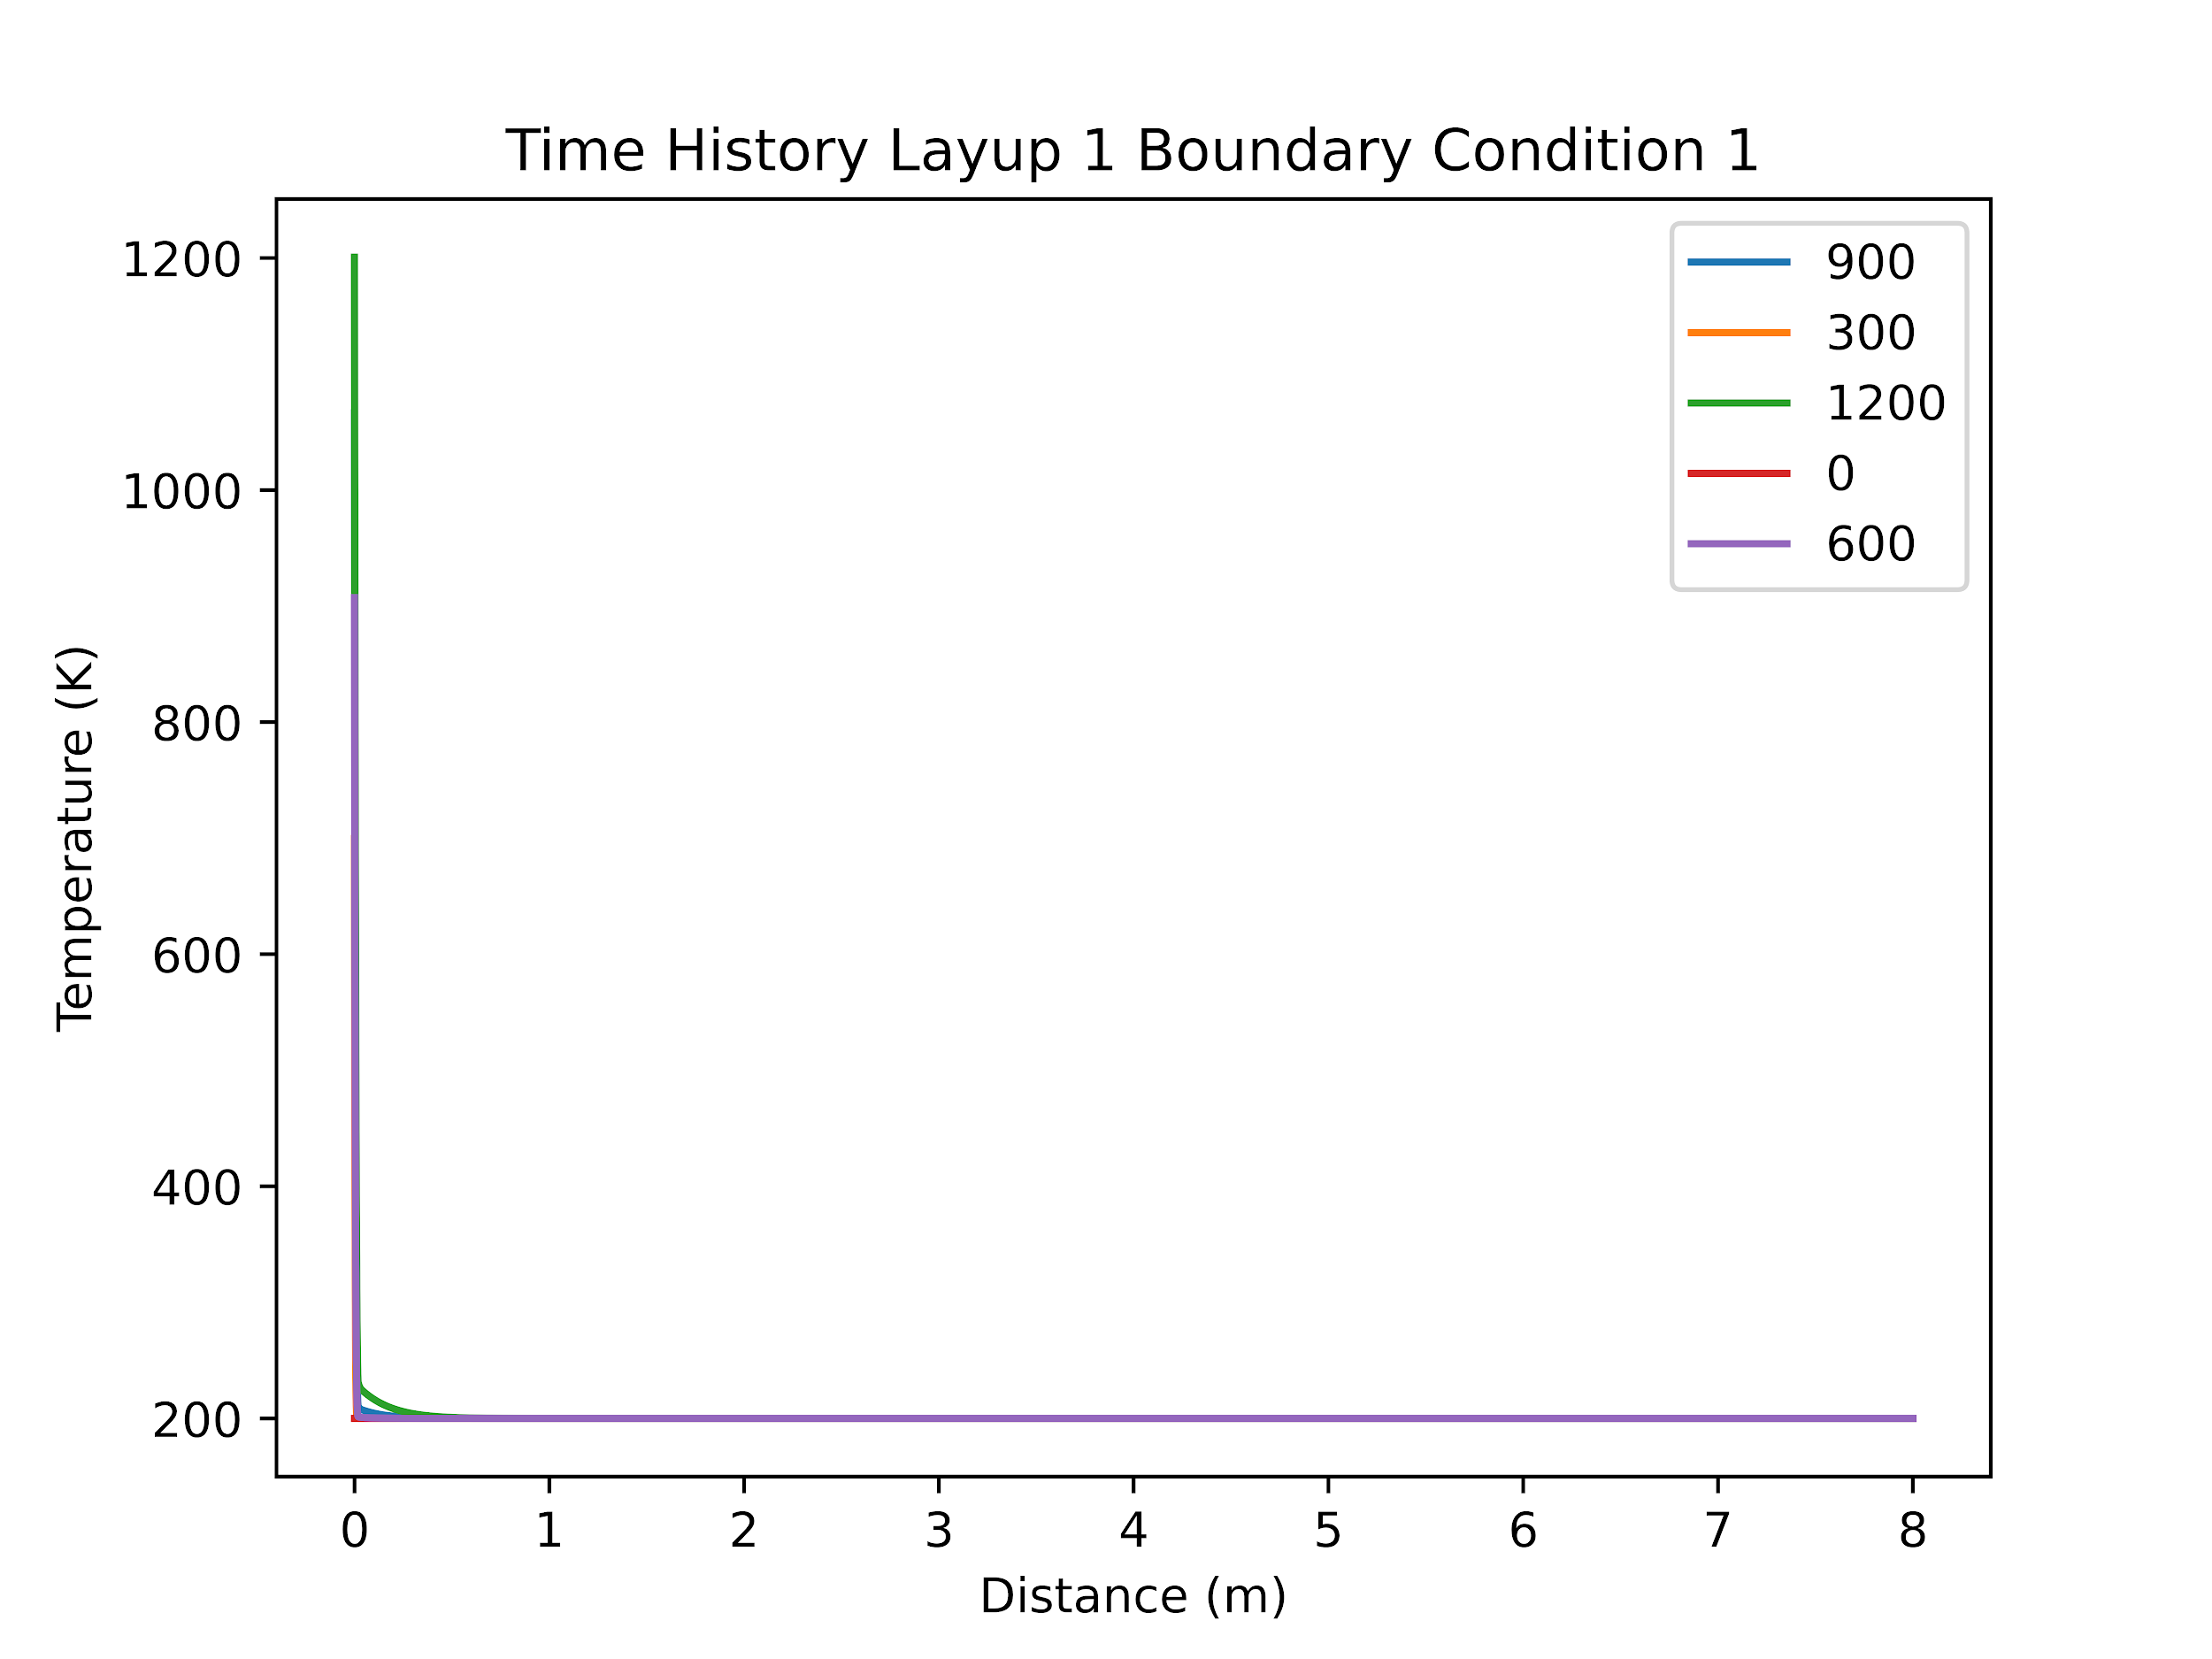
Results: Layup 1 Boundary Condition 1
All materials survived

Slide 17

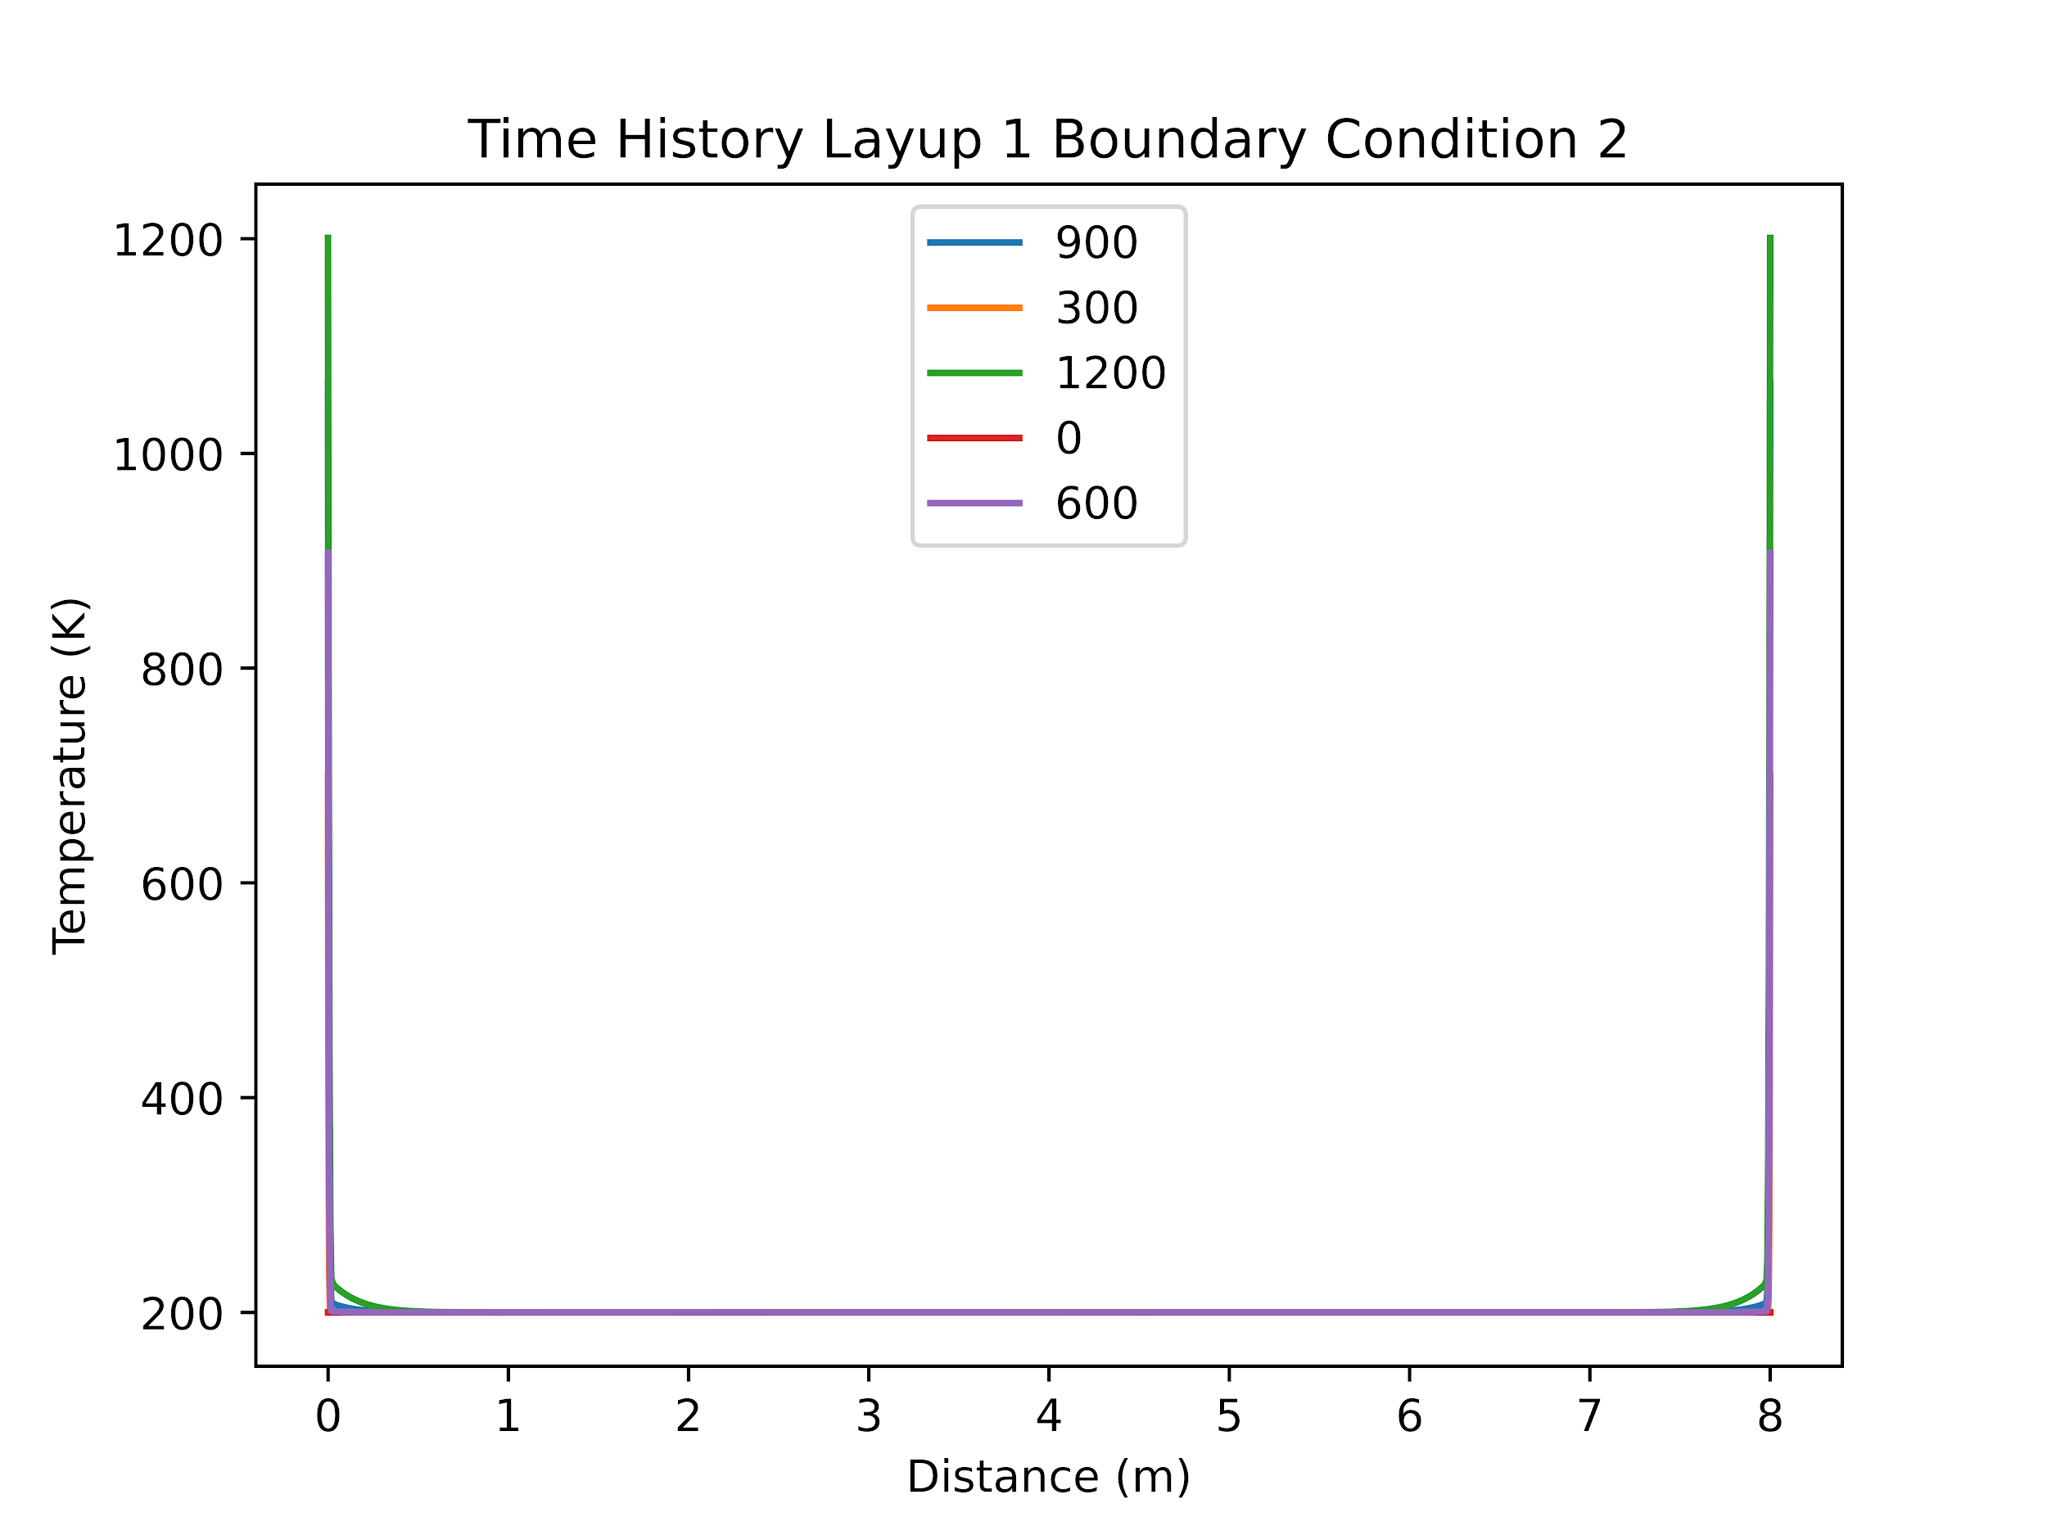
Layup 1 Boundary Condition 2
All material survived these boundary conditions.

Slide 18
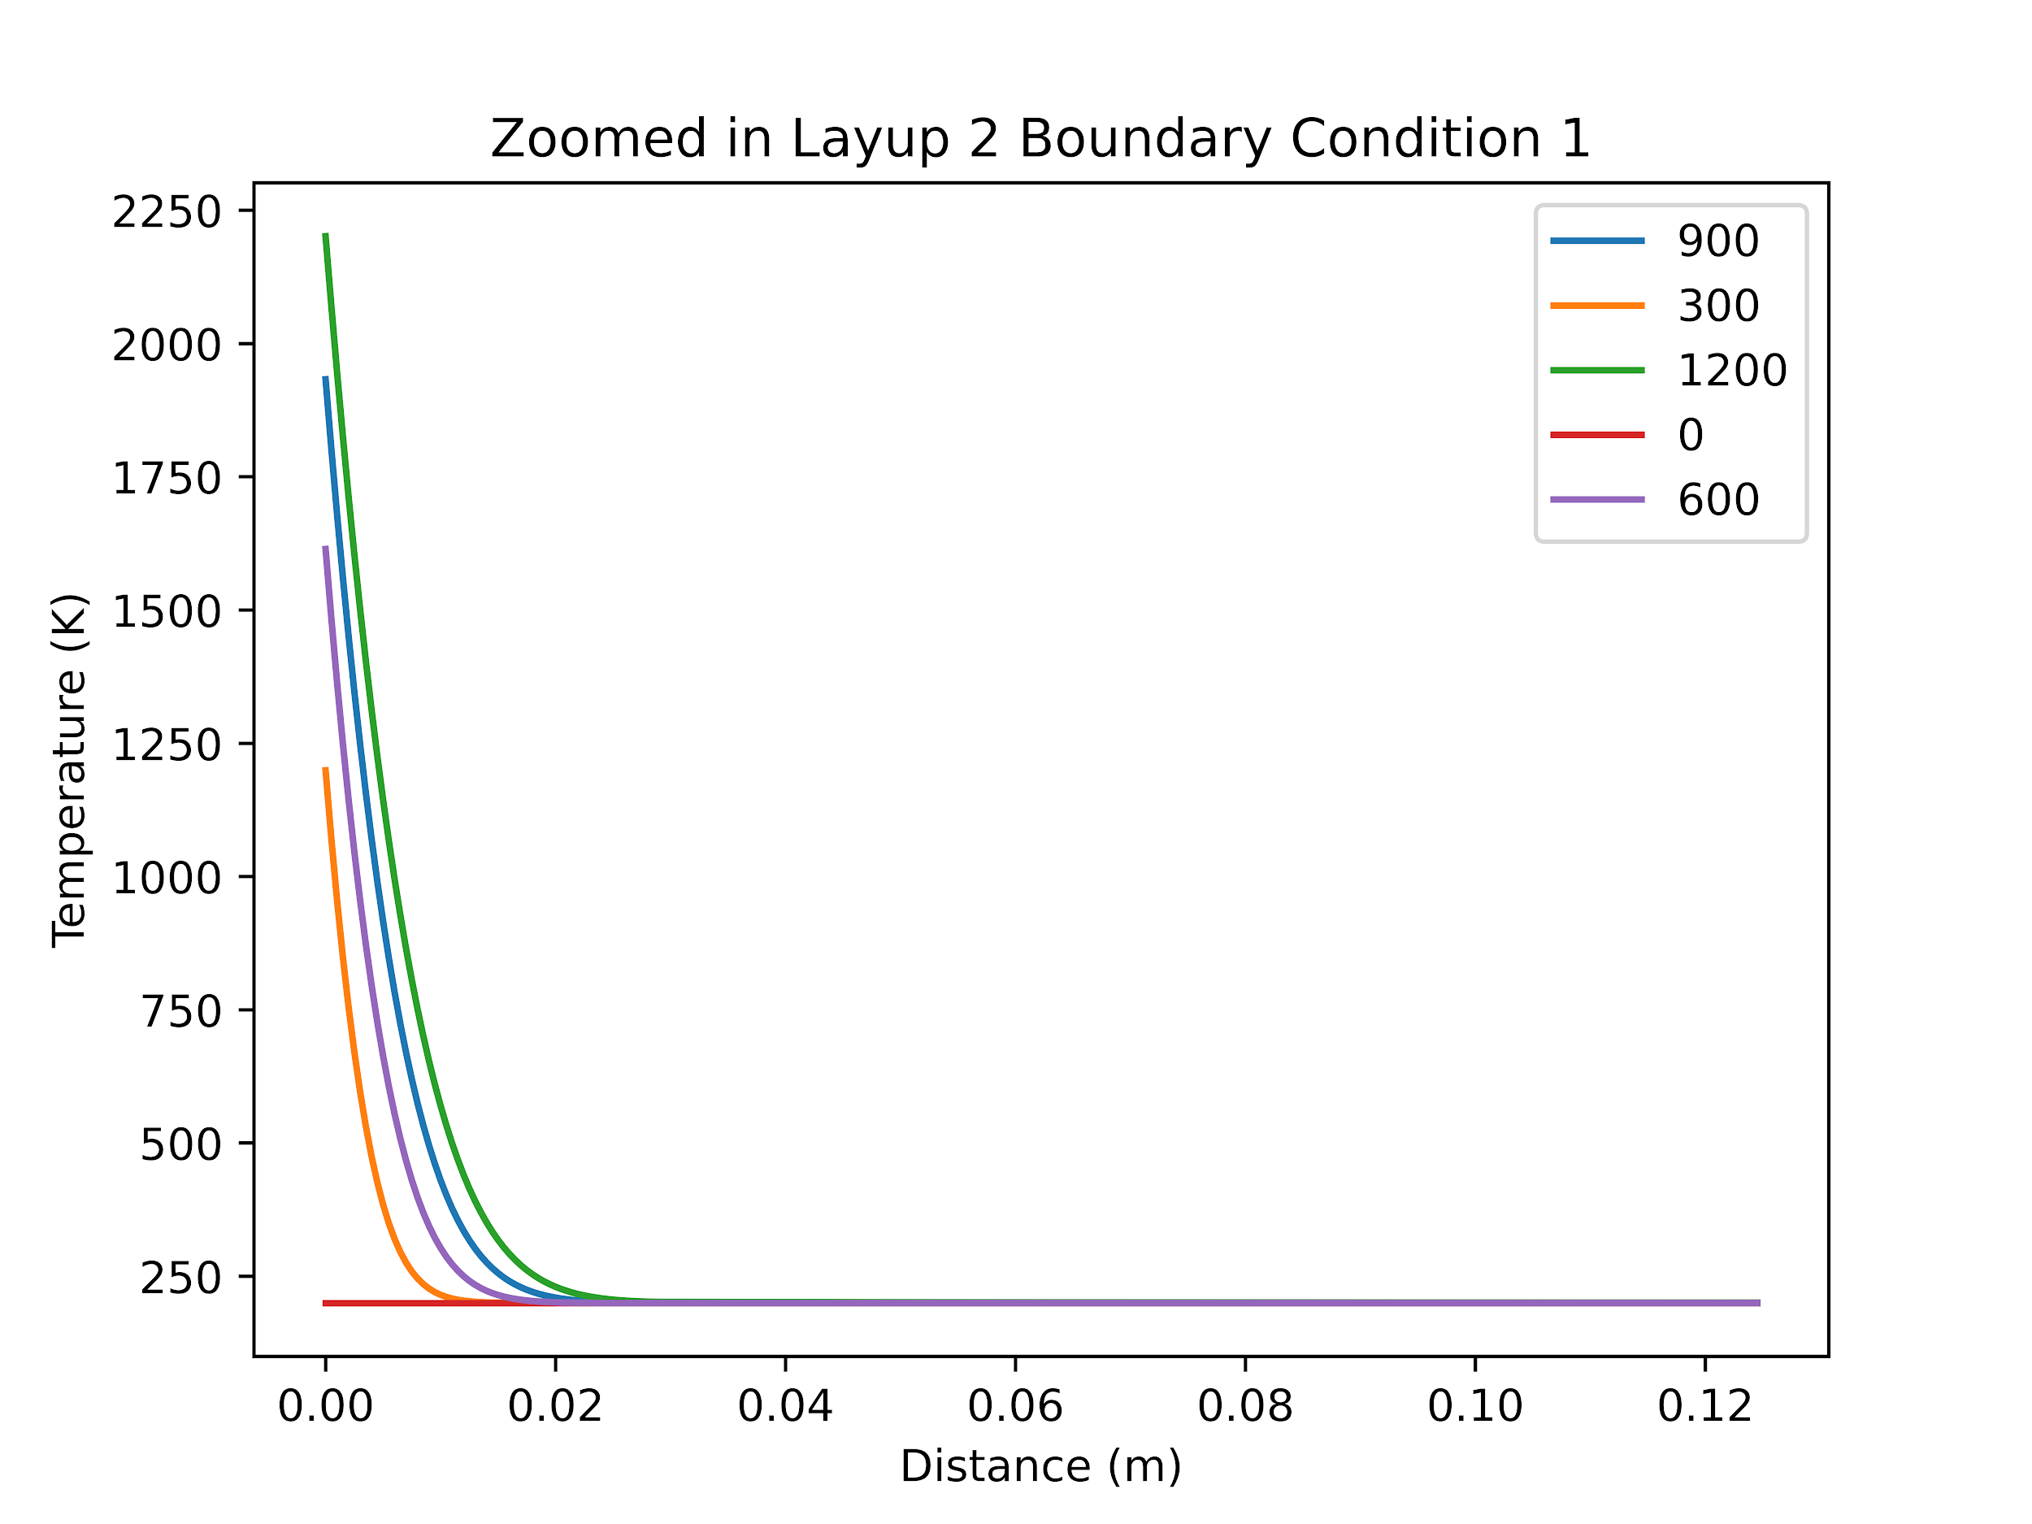
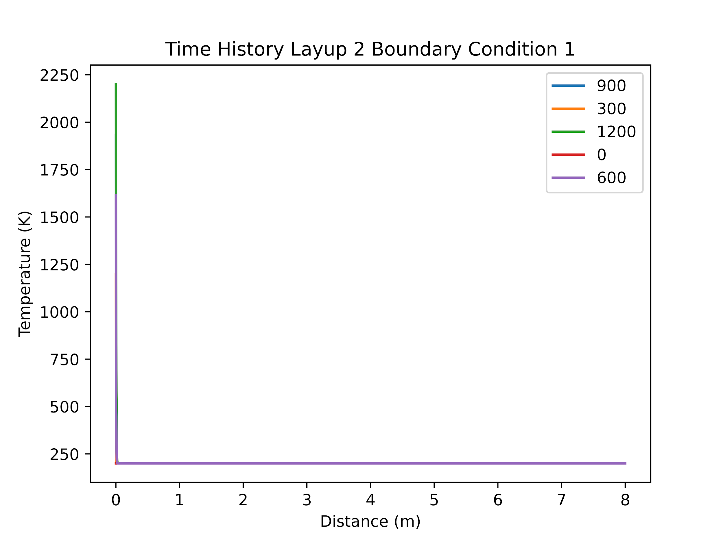
Layup 2 Boundary Condition 1
The outer layer of felt failed at 346 seconds all other materials survived.

Slide 19

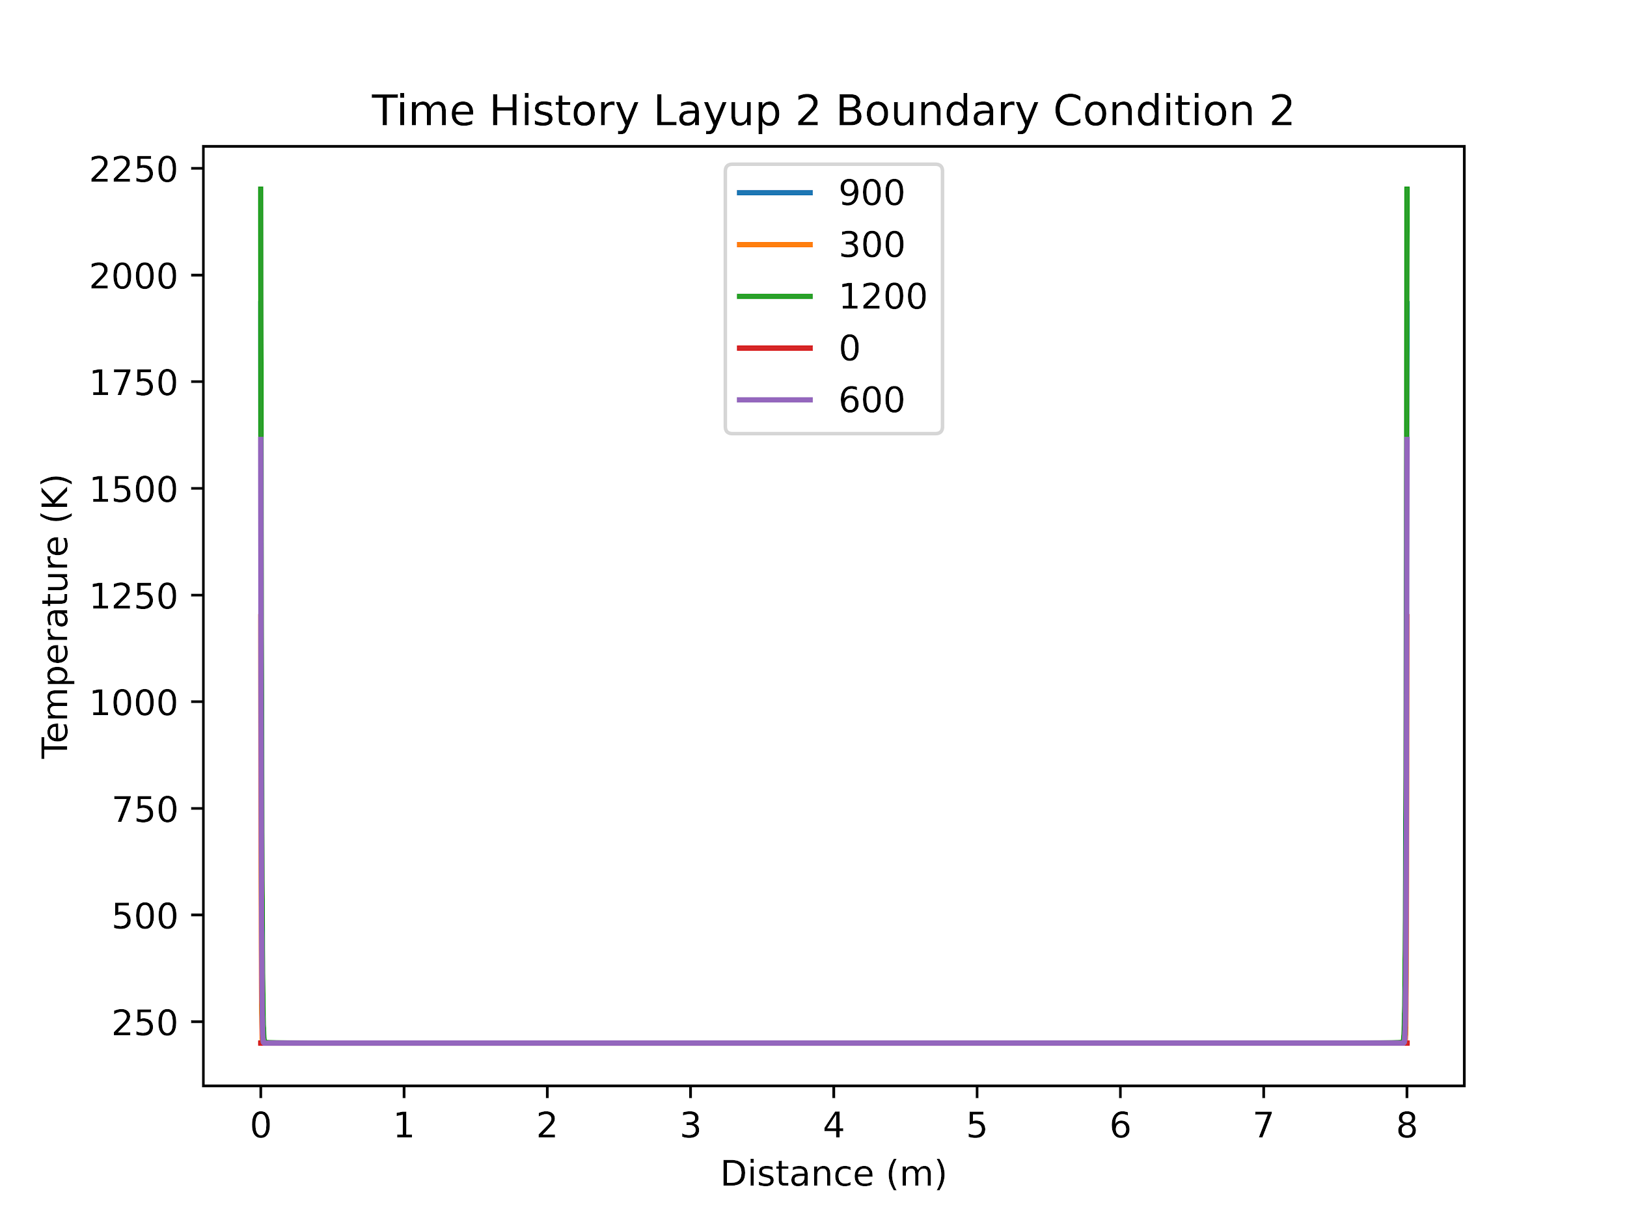
Layup 2 Boundary Condition 2
The outer layer of felt failed at 346 seconds all other materials survived.
No amount of additional felt would stop the outer layer from failing.

Slide 20
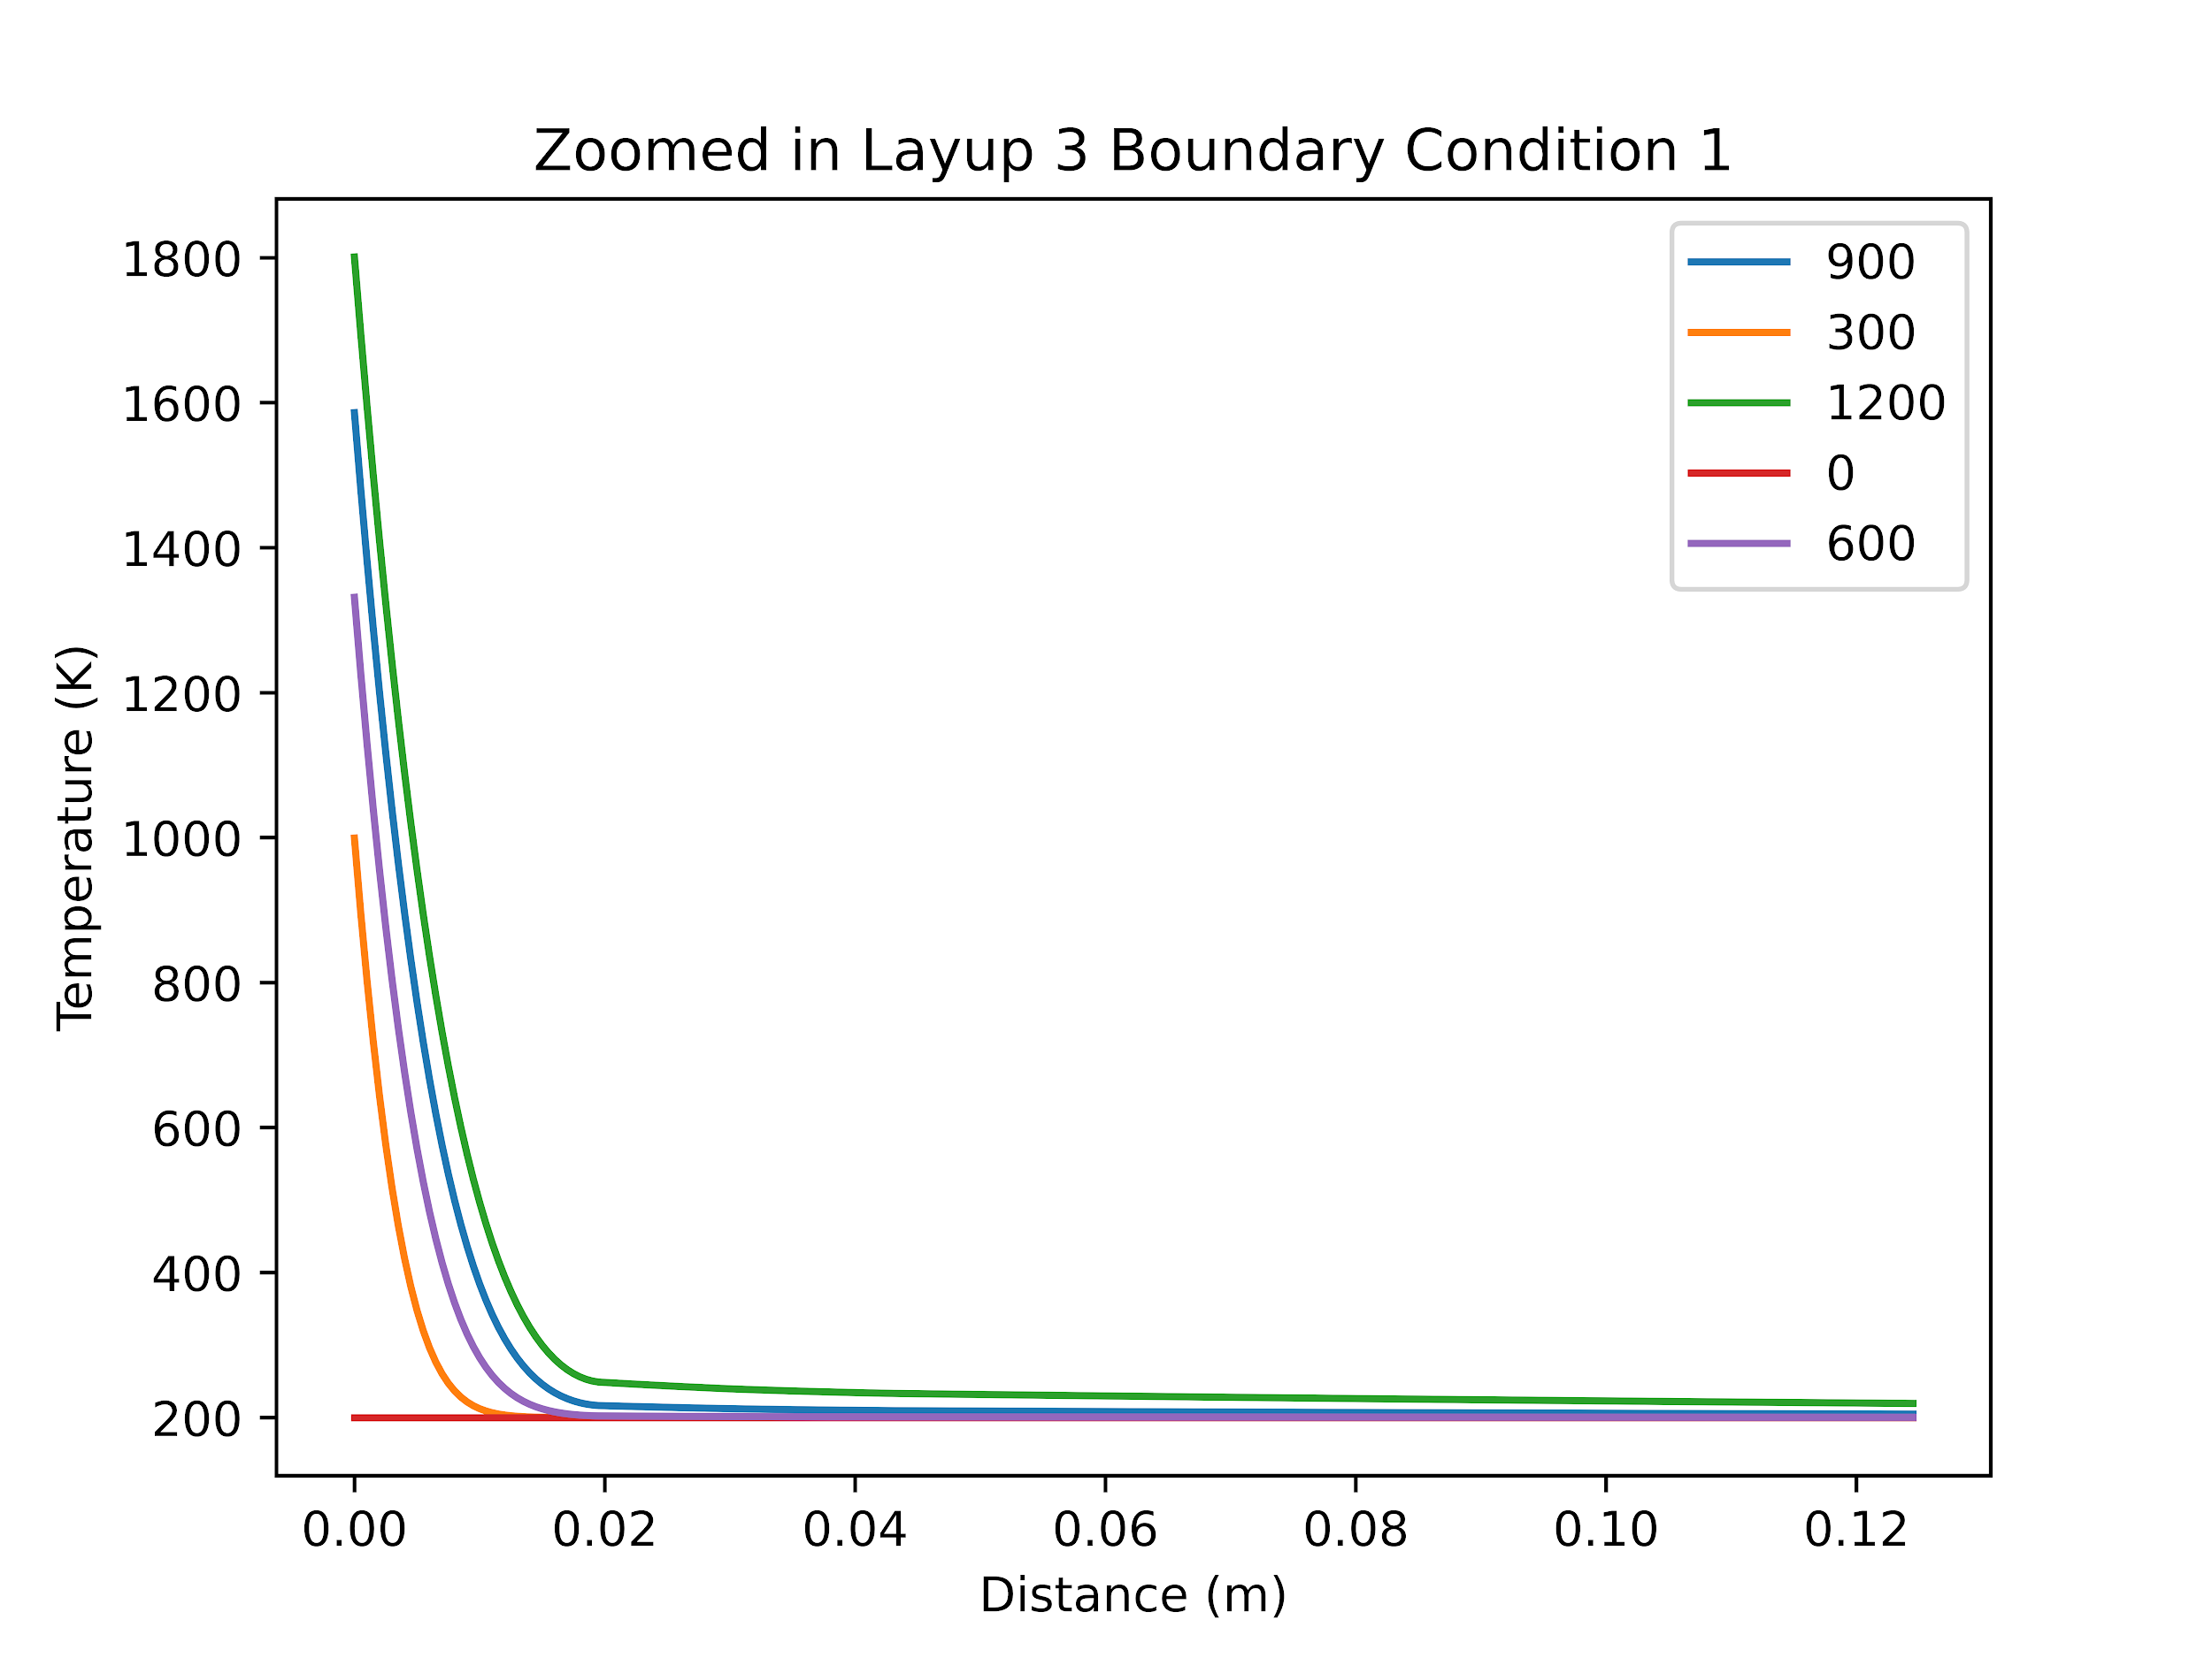
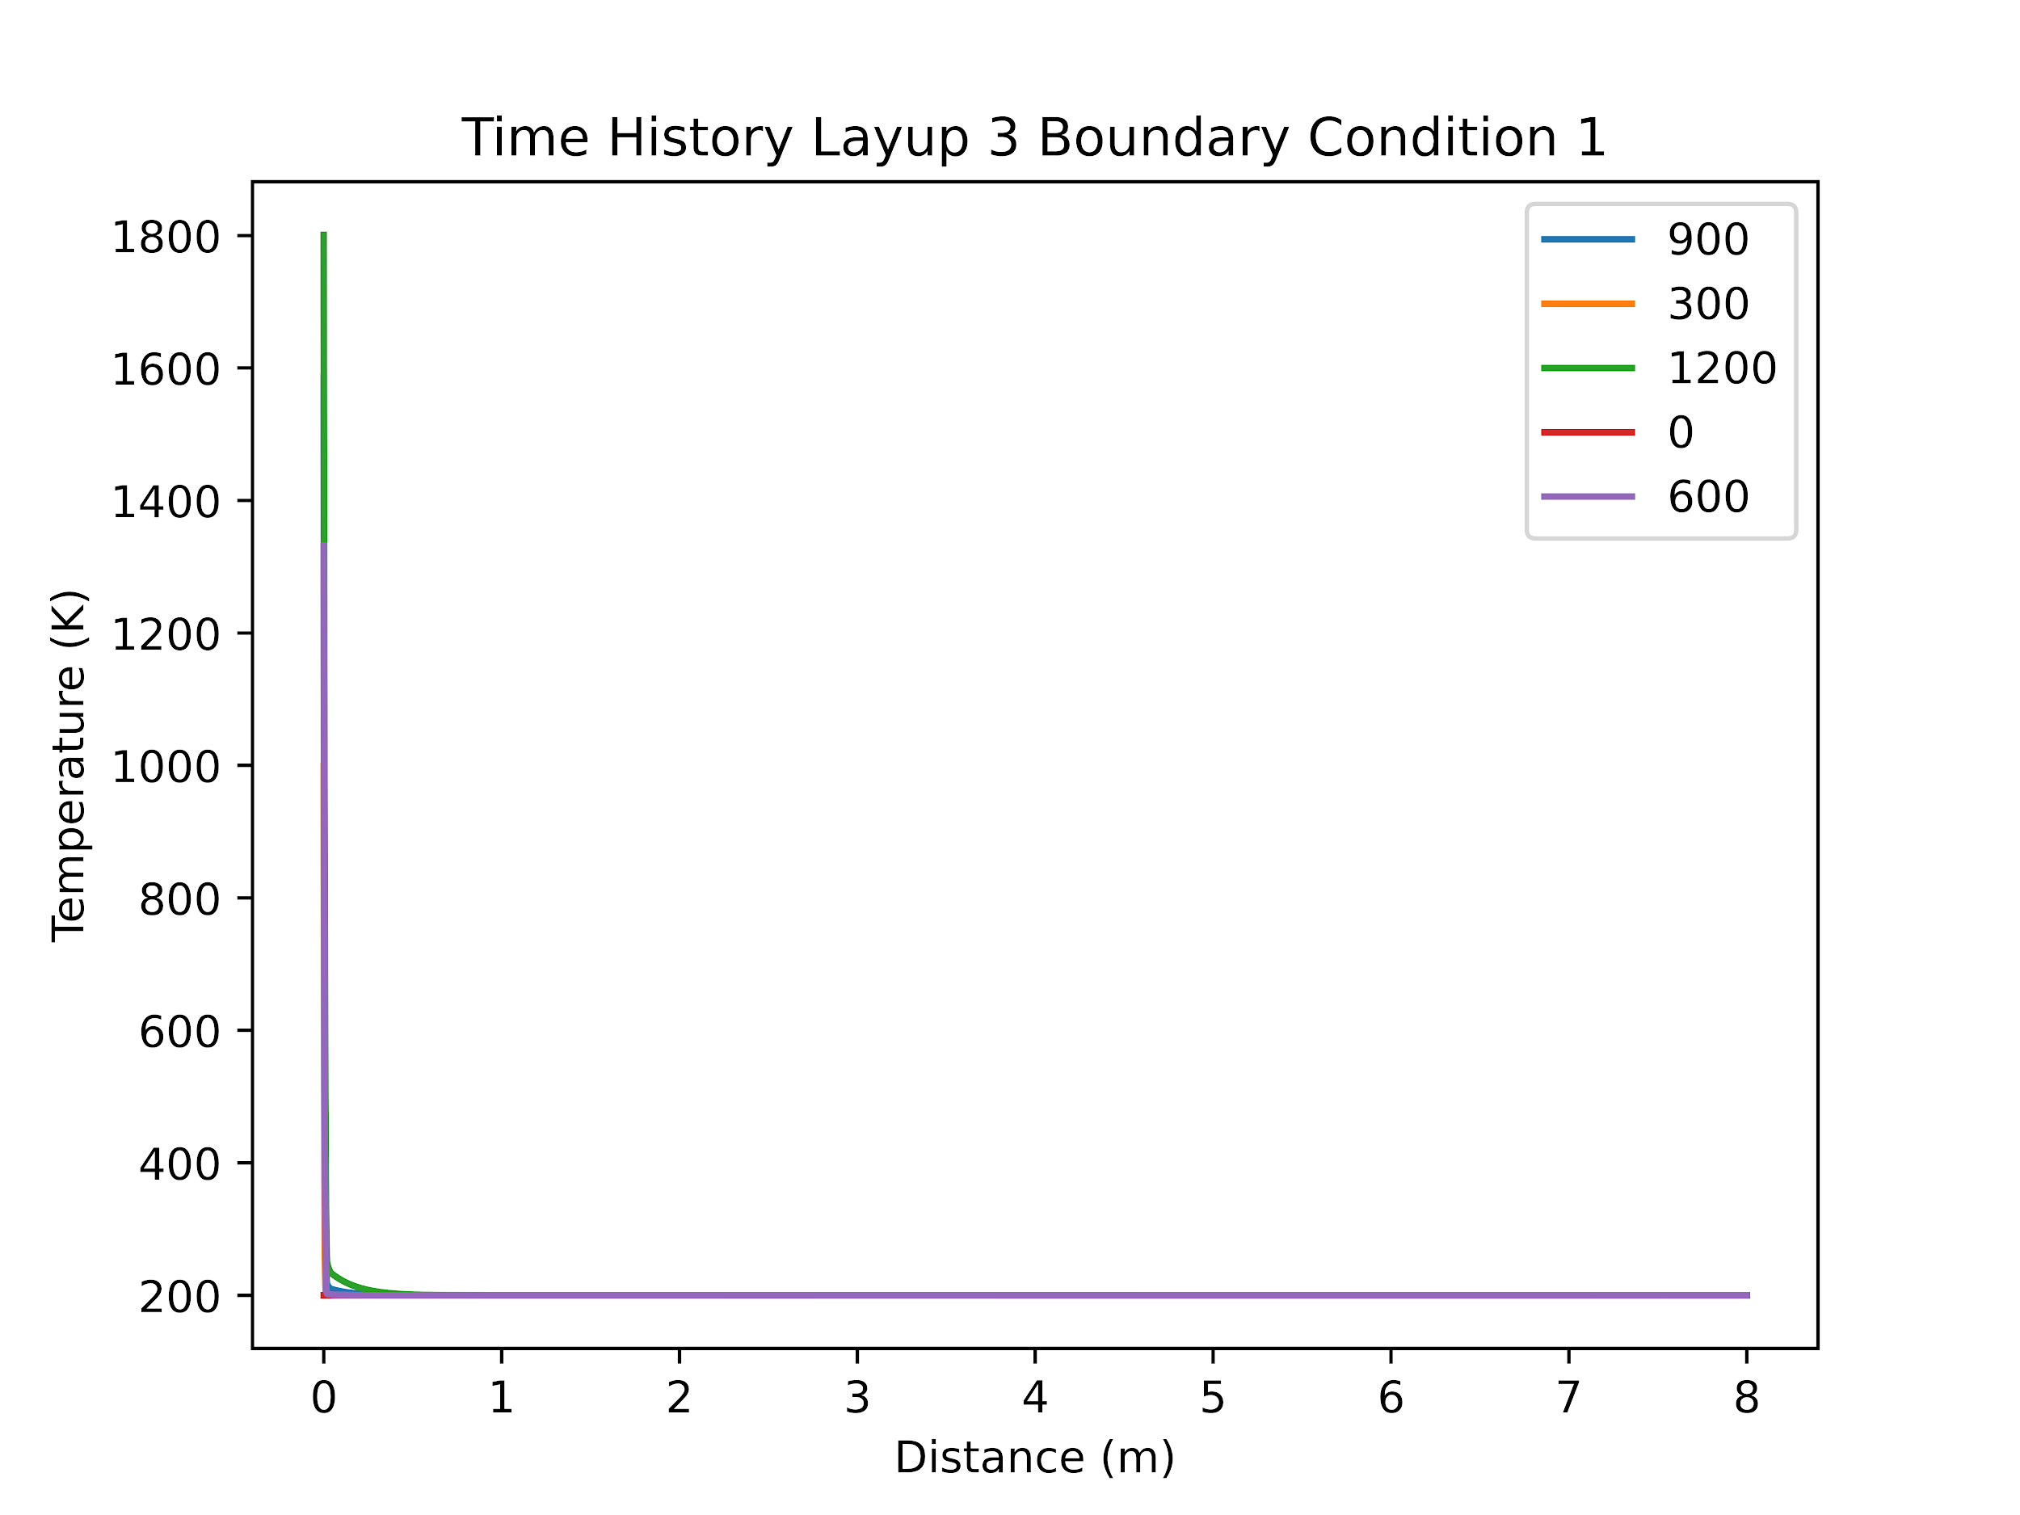
Layup 3 Boundary Condition 1
The outer layer of felt failed at 540 seconds, all other materials survived.

Slide 21

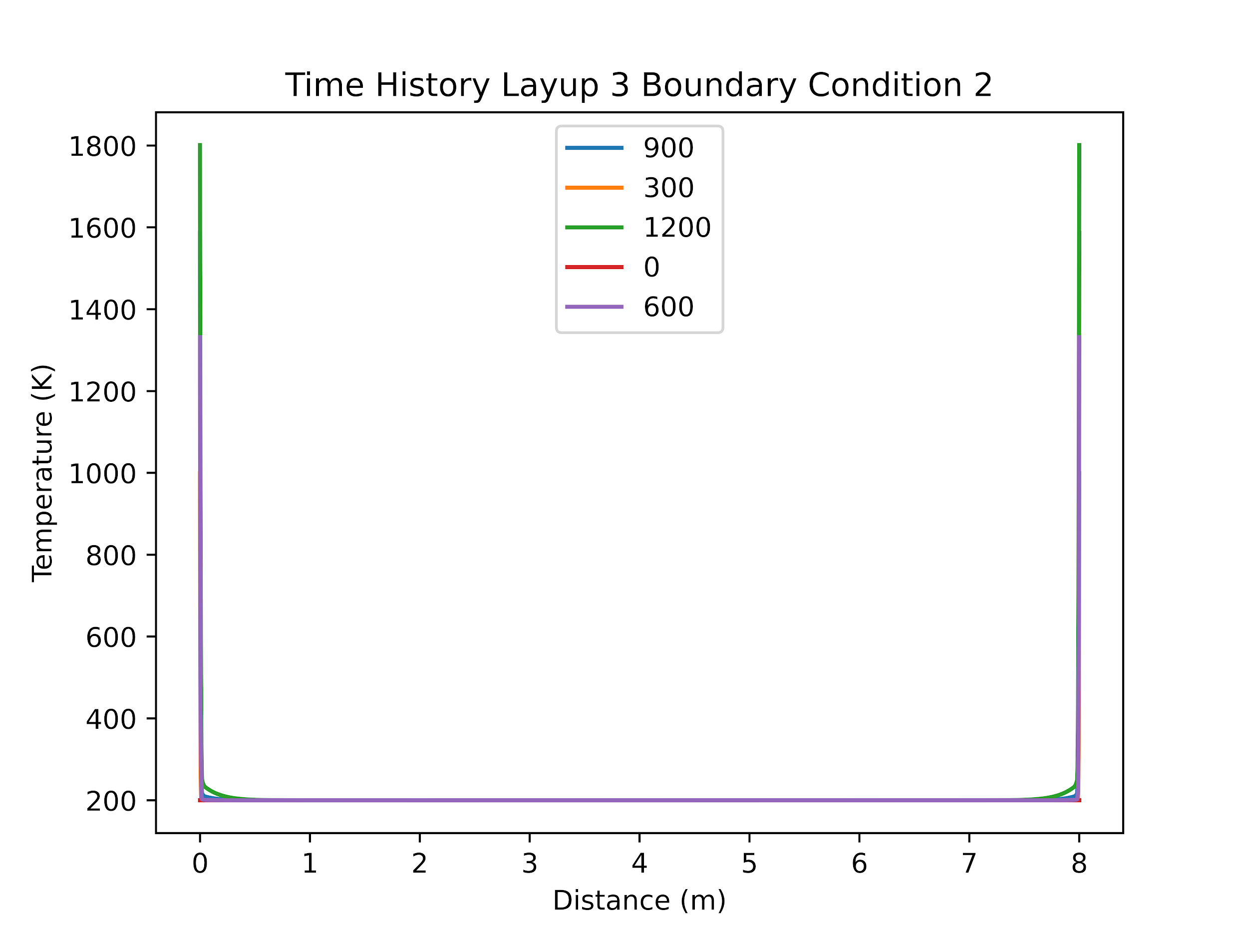
Layup 3 Boundary Condition 2
The outer layer of felt failed at 540 seconds, all other materials survived. No amount of additional felt would stop the outer layer from failing.

Slide 22
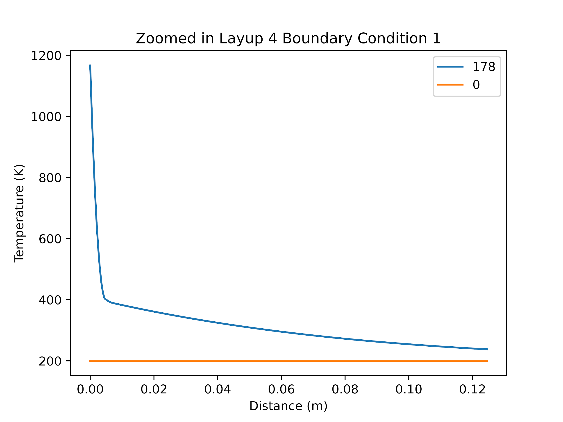
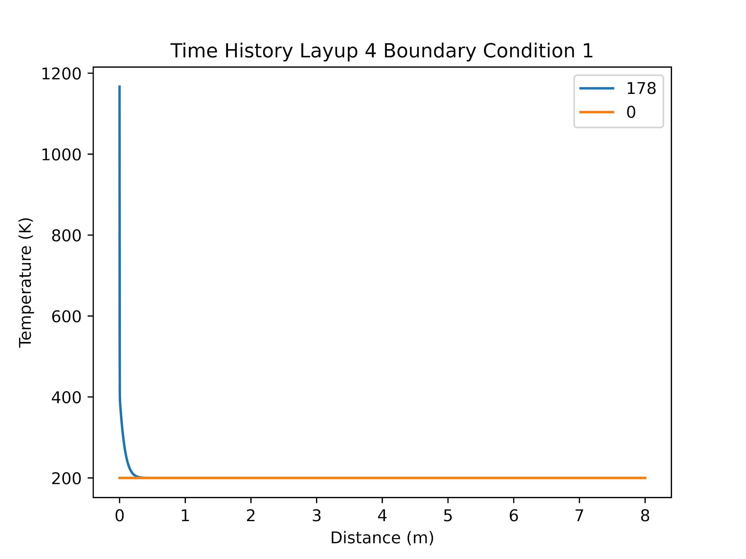
Layup 4 Boundary Condition 1
Epoxy failed at t = 178 seconds.

Slide 23
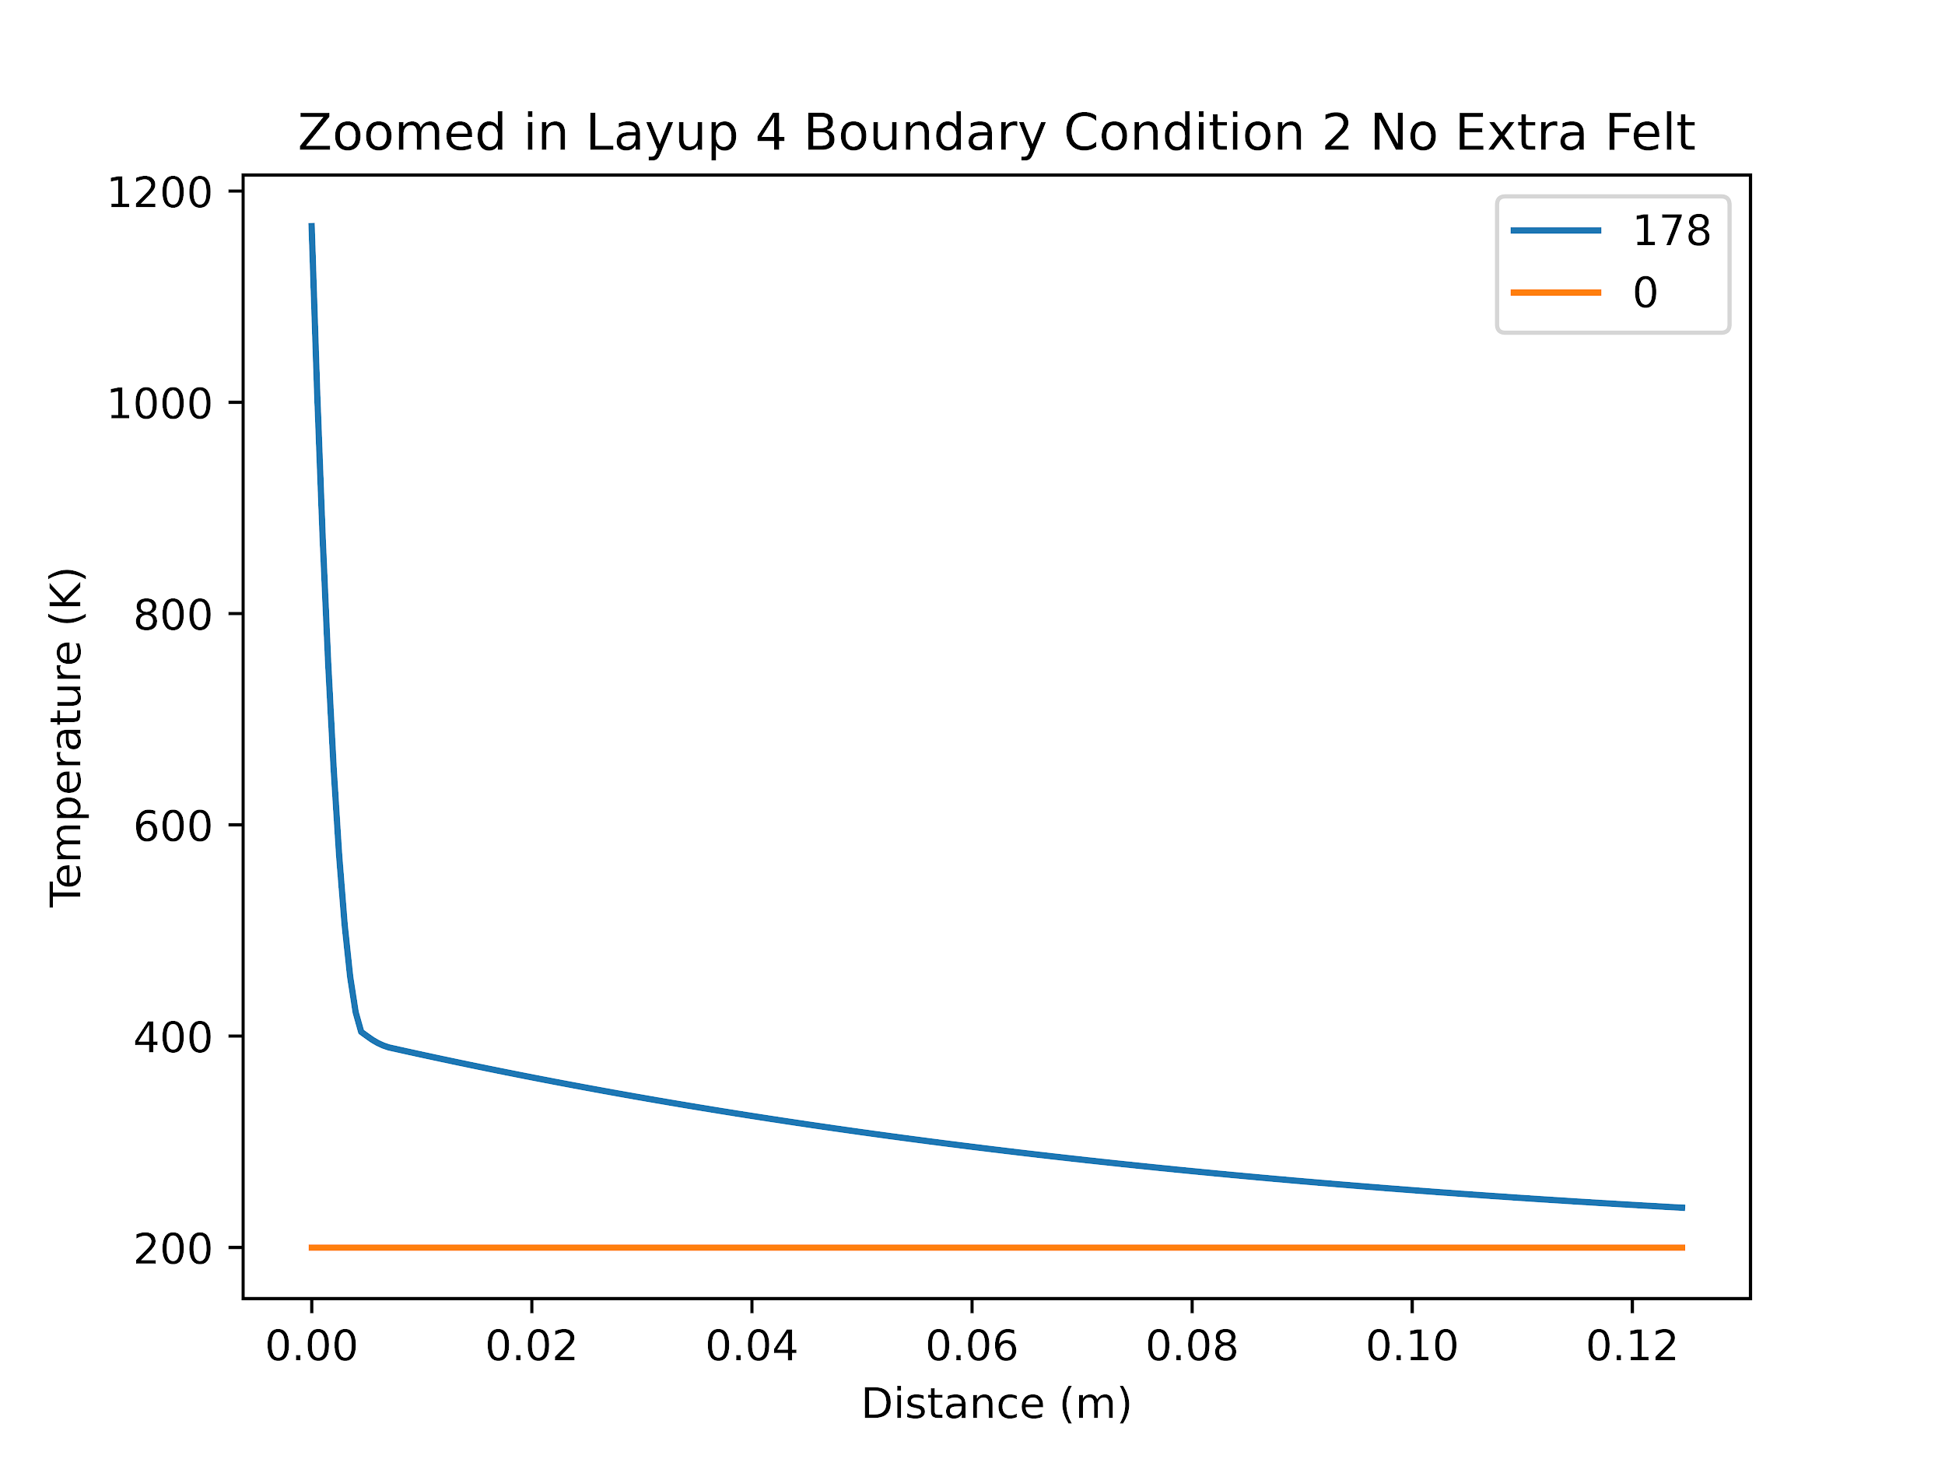
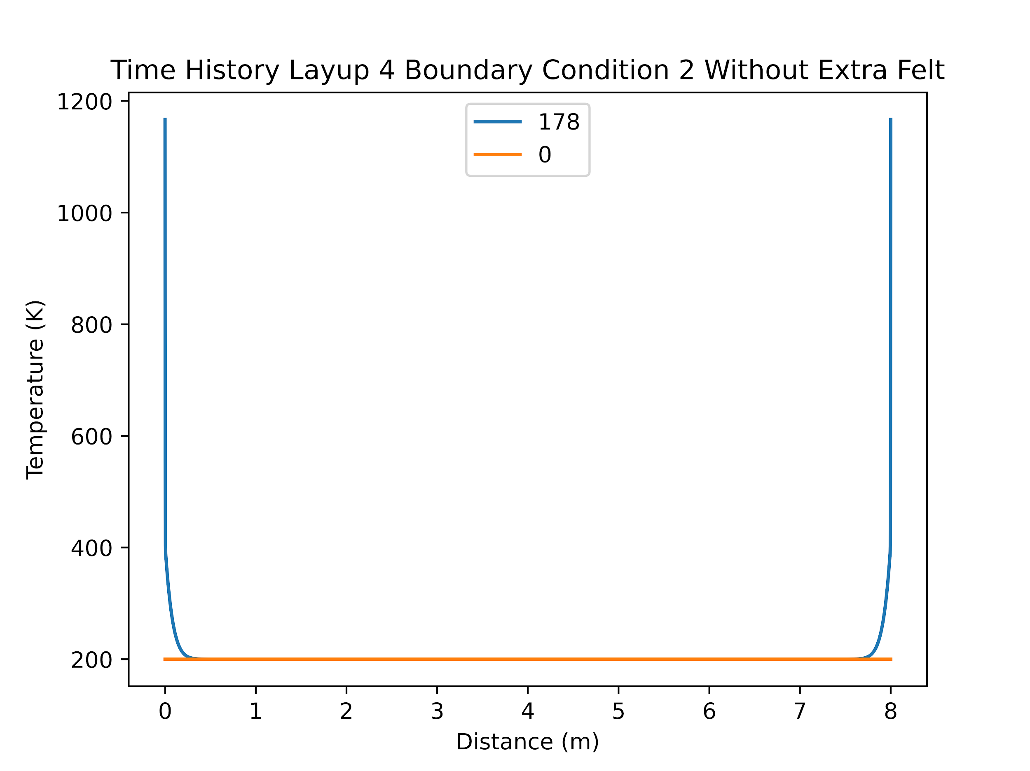
Layup 4 Boundary Condition 2 No Added Felt
EEpoxy failed at t = 178 seconds.

Slide 24
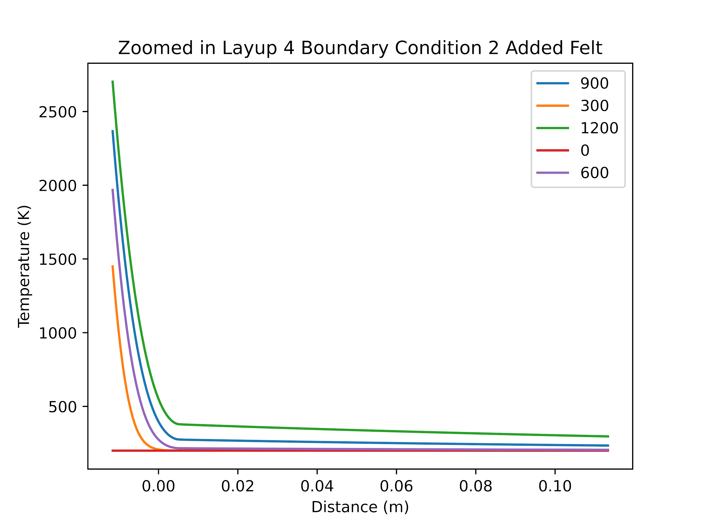
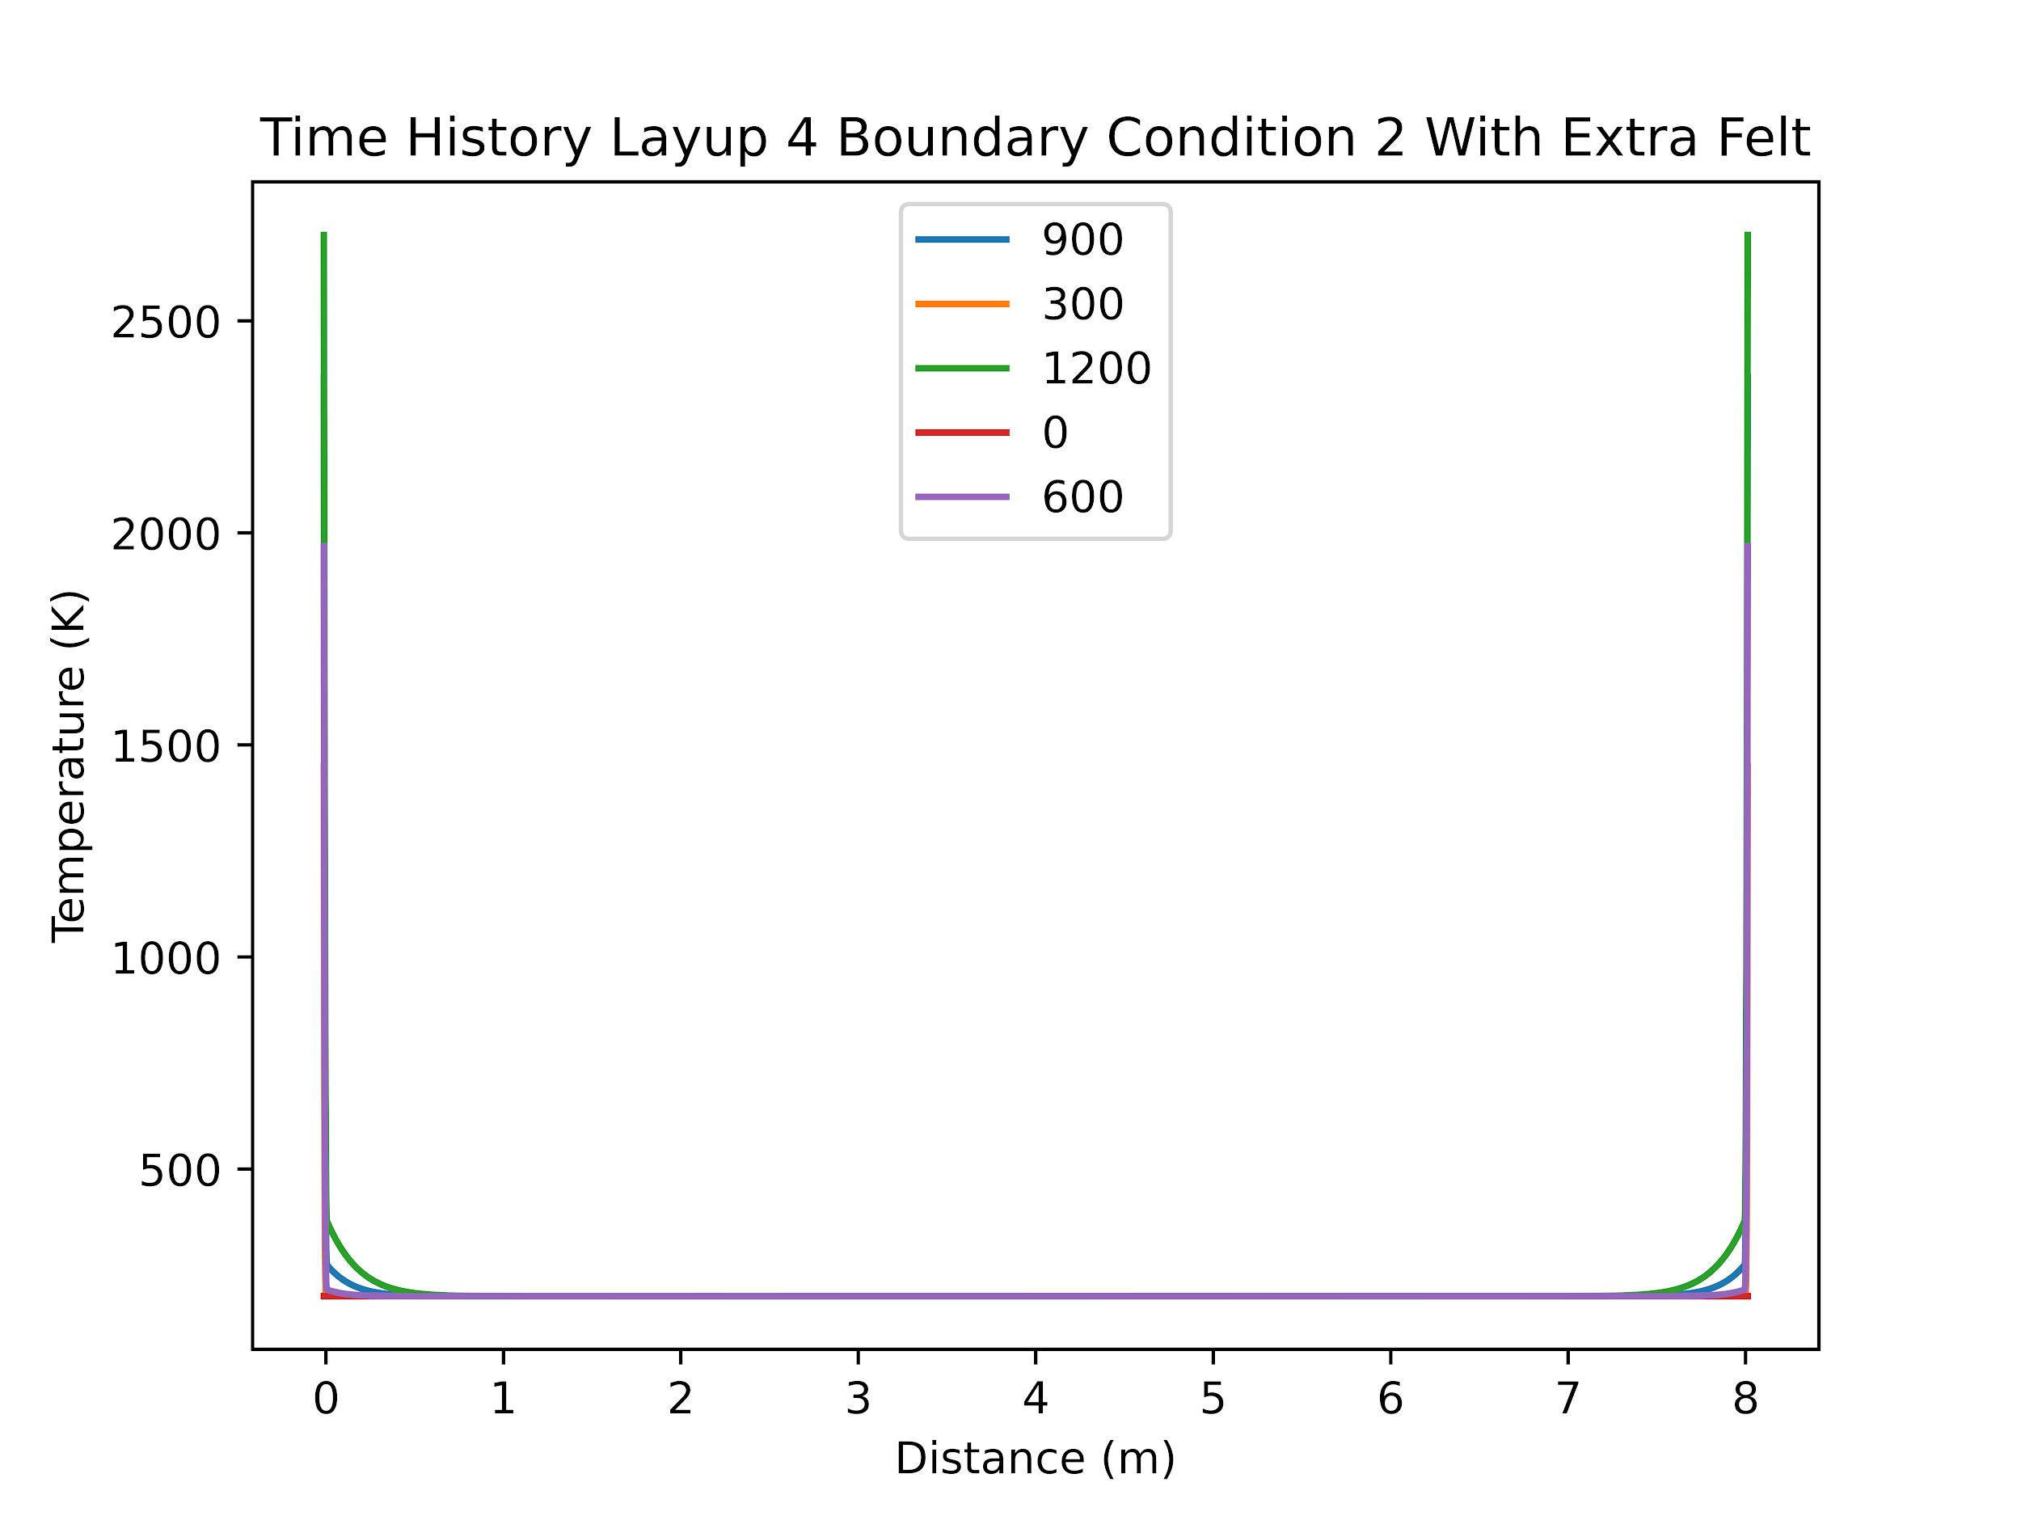
Layup 4 Boundary Condition 2 Additional Felt
The addition of 0.01155m (1.155 cm) of felt was sufficient to keep all materials, besides the outer felt layer, from failing during the 20 minute interval.

Slide 25
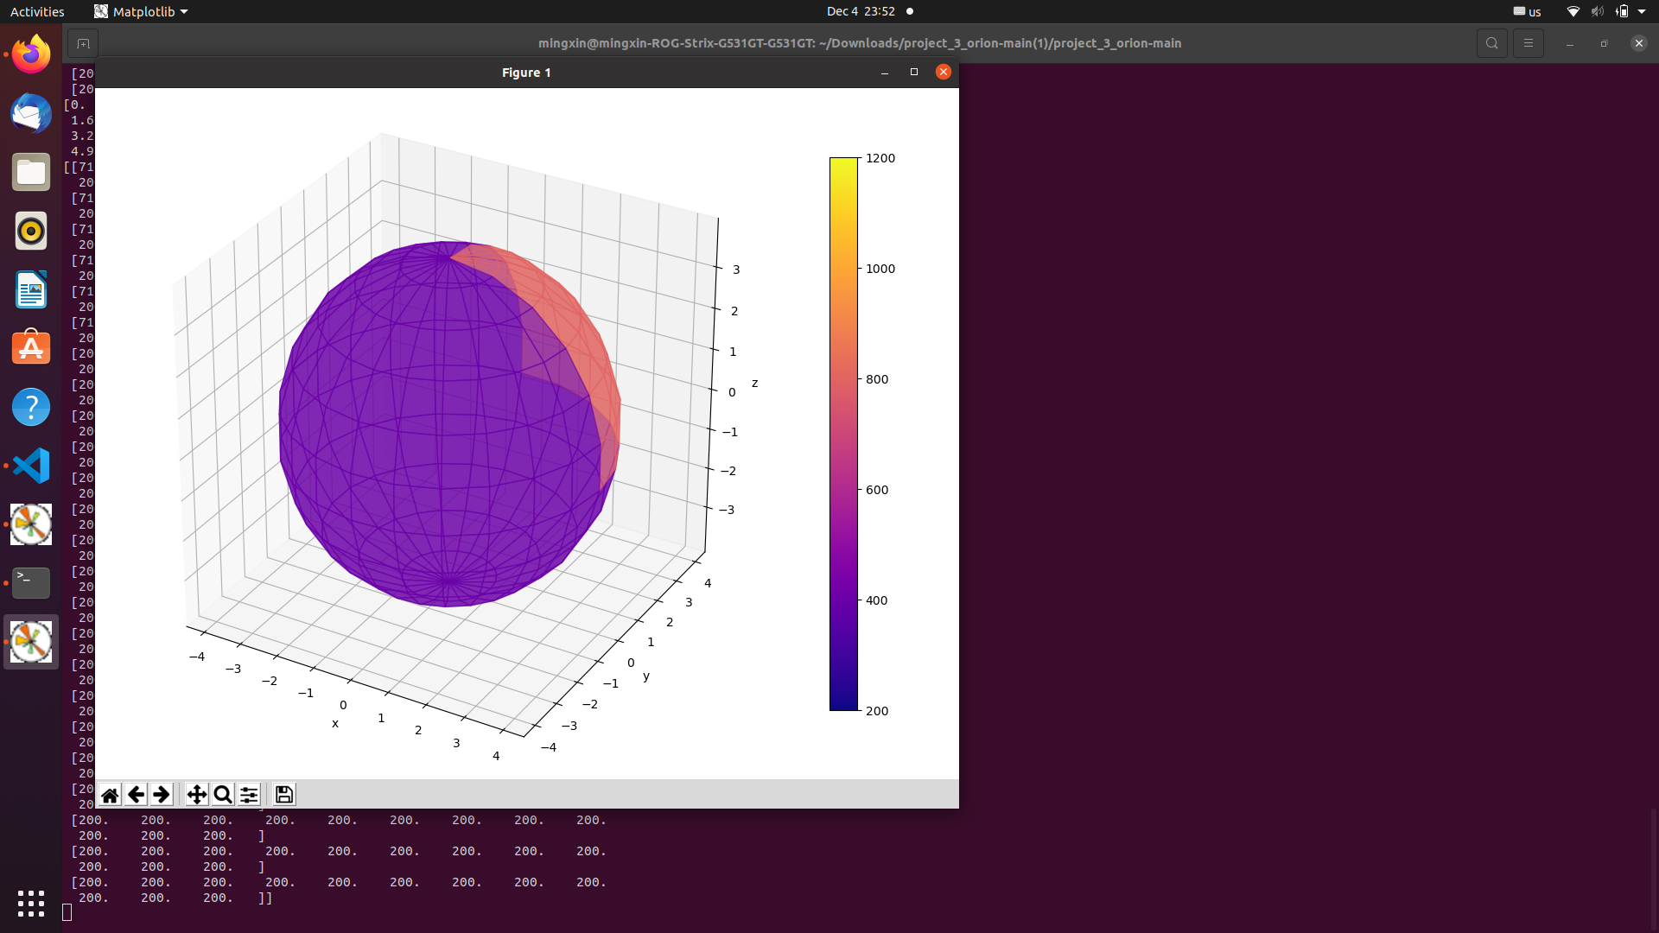
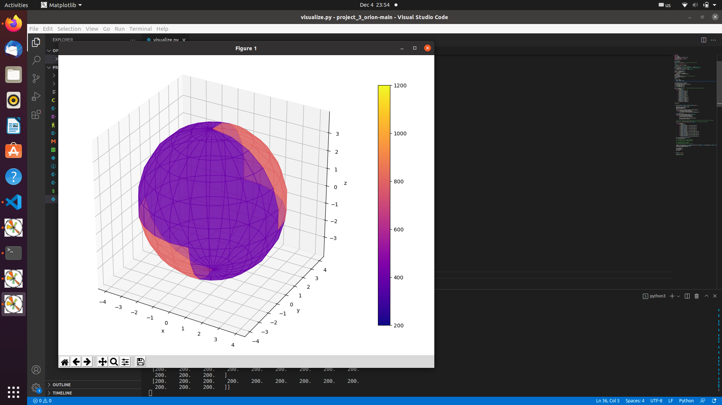
Optimization Feature: Visualization
Example:
Layup 1, BC = 1 / 2, (10th layer, t = 1200 by default)

Slide 26
Implement
Listen
Example
Brute Force
Implement
Walk through
Optimize
TEST

Slide 27
Code Features
Using a namespace
allowed for use of global variables and functions
Using global variables
allowed for multiple functions
easier debugging
Naming convention for functions
Action_Changed variable()

Slide 28
Modularity
Three separate cpp files for different functionality
setup.cpp
sets up solver parameters
data.cpp
handles data coming in and out of the solver
solver.cpp
handles matrix operations and saving temperature values
Separate python files for plotting
plot.py
plots multiple time steps over the diameter
visualization
created a three dimensional figure

Slide 29
Test
Listen
Example
Brute Force
Implement
Walk through
Optimize
TEST

Slide 30
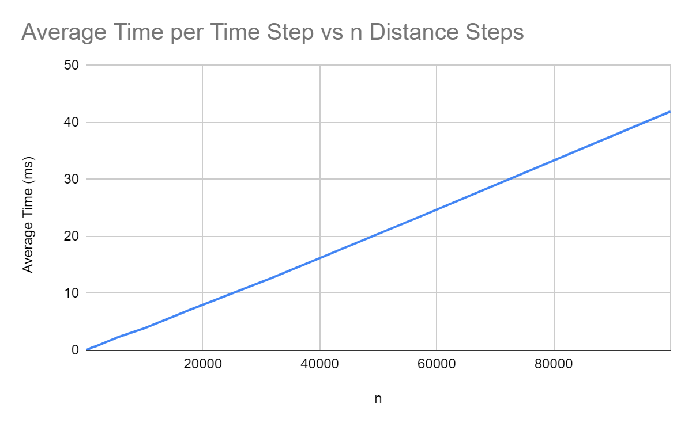
Runtime
Average runtime per time step increases linearly with an increase in the number of steps across the radius.

Slide 31
Thank you!

Slide 32
Citations
304 stainless steel. (n.d.). Retrieved November 5, 2022, from https://www.matweb.com/search/DataSheet.aspx?MatGUID=abc4415b0f8b490387e3c922237098da
Aluminum, AL. (n.d.). Retrieved December 4, 2022, from https://www.matweb.com/search/datasheet.aspx?bassnum=AMEAL00
Carbon and Graphite Felt Properties. graphite-eng.com. (1997, September 16). Retrieved November 18, 2022, from https://www.graphite-eng.com/uploads/downloads/carbon_and_graphite_felt.pdf
The density of aluminium and its alloys - thyssenkrupp materials (UK). Materials UK. (n.d.). Retrieved December 4, 2022, from https://www.thyssenkrupp-materials.co.uk/density-of-aluminium.html#:~:text=The%20density%20of%20aluminium%20is,m3%20and%202%2C810kg%2Fm3.
DragonPlate. (n.d.). Dragonplate: Engineered carbon fiber composite sheets, tubes and structural components: Made in USA. Dragon Plate. Retrieved November 5, 2022, from https://dragonplate.com/carbon-fiber-thermal-conductivity-and-the-coefficient-of-thermal-expansion
Heat capacities for some select substances. (n.d.). Retrieved November 18, 2022, from https://gchem.cm.utexas.edu/data/section2.php?target=heat-capacities.php
High temperature felts. Final Advanced Materials. (n.d.). Retrieved December 3, 2022, from https://www.final-materials.com/gb/308-high-temperature-felts-and-blankets
Instruments, F. F. P., Inc., F. T. E. S. C. A. N. U. S. A., Spectroscopy, F. R. plc-, Inc., F. G., Technologies, F. S., Scientific, F. H. O. R. I. B. A., & PLC, F. A. P. (2022, December 2). Properties: Stainless steel - grade 304 (UNS S30400). AZoM.com. Retrieved December 3, 2022, from https://www.azom.com/properties.aspx?ArticleID=965
Kirova, E. M., & Pisarev, V. v. (2019). The glass transition criteria for aluminum-copper melt. Journal of Physics: Conference Series. https://doi.org/10.1088/1742-6596/1147/1/012014
Metallic materials - all Seals Inc. (n.d.). Retrieved November 5, 2022, from https://allsealsinc.com/teadit/TypicalMetalProperties.pdf
The Online Materials Information Resource. MatWeb. (n.d.). Retrieved November 5, 2022, from https://www.matweb.com/search/datasheet.aspx?matguid=39e40851fc164b6c9bda29d798bf3726&ckck=1
The Online Materials Information Resource. Overview of materials for epoxy adhesive. (n.d.). Retrieved November 5, 2022, from https://www.matweb.com/search/datasheet_print.aspx?matguid=c1ec1ad603c74f628578663aaf44f261
The Online Materials Information Resource. Overview of materials for epoxy cure resin. (n.d.). Retrieved November 5, 2022, from https://www.matweb.com/search/datasheet_print.aspx?matguid=956da5edc80f4c62a72c15ca2b923494
Pure Silica Felts 1200°C. Final Advanced Materials. (n.d.). Retrieved December 3, 2022, from https://www.final-materials.com/gb/309-ultra-pure-silica-felts-1200c

Slide 33
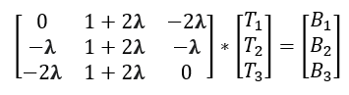
Backup Slides Thomas Algorithm
Matrix Update Start at the second row ratio = A[i][0] / A[i - 1][1] A[i][1] = A[i][1] - ratio*A[i-1][2] B[i] = B[i] - ratio*B[i - 1] iterate i forward | Backwards Solving Start at the last B value T[n - 1] = B[n - 1]/A[n - 1][1] Begin Loop T[i] = (B[i] - A[i][2]*T[i + 1]) / A[i][1] iterate i backwards

Slide 34
Backup Slides Results Parameters
Results Parameters
Number of steps | 16000
Time step | 1 second
Final time | 20 minutes (1200 seconds)
Saving interval | 300 seconds

Slide 35
Run Time Data
n | avg time (ms) | n | avg time (ms)
10 | 0.00605333 | 1000 | 0.500405
17 | 0.0102158 | 1778 | 0.75836
32 | 0.0192833 | 3162 | 1.35106
56 | 0.032104 | 5623 | 2.38145
100 | 0.05697 | 10000 | 3.88103
177 | 0.10194 | 17782 | 7.12832
316 | 0.18231 | 31622 | 12.6598
562 | 0.286038 | 56234 | 23.0909
 |  | 100000 | 41.9479

Slide 36
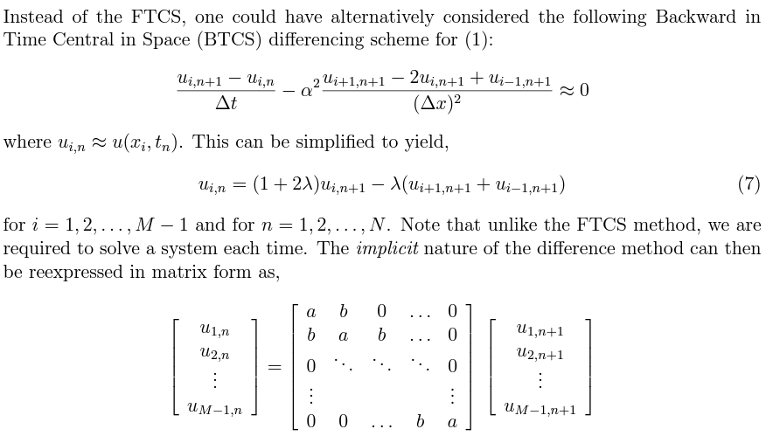
Algorithm: Backward Iteration
Cited from lecture slide no.11 & 12

